Slide 1
Welcome!
Workshop
6 of 7

Slide 2
Today's Topics
Review of Workshop 5
Graphs & Charts
Error Handling
Debugging

Slide 3
Review Question 1
True or False?
You must create a descriptive icon for a subVI and wire the connector pane

Slide 4
Review Question 1
True or False?
You must create a descriptive icon for a subVI and wire the connector pane
FALSE
Notes:
You are not required to create a descriptive icon, although it is recommended. The connector pane, on the other hand, needs to be wired if you want to pass values in and out of the subVI (or force data flow using something like the error wire…)

Slide 5
Review Question 2
On a subVI, which terminal setting causes an error if the terminal is not wired?
Required
Recommended
Optional

Slide 6
Review Question 2
On a subVI, which terminal setting causes an error if the terminal is not wired?
Required
Recommended
Optional
Notes:
If a required terminal is not wired, the VI will have a broken run arrow (an error) and cannot execute.

Slide 7
Review Question 3
True or False?
Descriptions appear in the Context Help window.

Slide 8
Review Question 3
True or False?
Descriptions appear in the Context Help window.
TRUE
Notes:
You create descriptions by
right-clicking on the control/indicator/constant and selecting Properties: Documentation
right-clicking on the VI Icon and selecting VI Properties: Documentation
Selecting VI Properties from the File menu and selecting Documentation from the drop down box

Slide 9
Review Question 4
Which of the following forms of documentation are available on the block diagram?
Free labels
Labels
Captions
Tip strips

Slide 10
Review Question 4
Which of the following forms of documentation are available on the block diagram?
Free labels
Labels
Captions
Tip strips
Notes:
Labels are one way to identify a control/indicator terminal on the block diagram. Free labels can be used to add additional information about long wires or algorthims.
Captions and tip strips are only available on the front panel.

Slide 11
Review Question 5
Which of the following statements are true about high-level File I/O Vis?
High-level File I/O functions are more efficient than low-level I/O
High-level File I/O functions perform the open/create, read/write, and close within the VI
High-level File I/O functions are specific to one file type

Slide 12
Review Question 5
Which of the following statements are true about high-level File I/O Vis?
High-level File I/O functions are more efficient than low-level I/O
High-level File I/O functions perform the open/create, read/write, and close within the VI
High-level File I/O functions are specific to one file type
Notes:
Because high-level file i/o functions perform all three steps of file i/o within the VI, everytime the VI is called all three steps must happen. Low-level file i/o functions split up the steps into separate VIs so the overhead associated with opening and closing files is minimized by only occurring once each
True!
The Write/Read Measurement File Express VIs are classified as high-level and they handle multiple file types including LVM and TDMS.

Slide 13
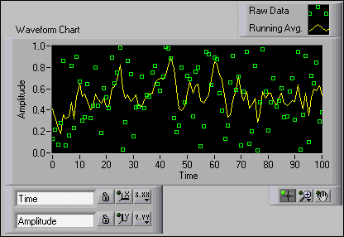
Waveform Graphs & Charts
Special type of numeric indicator that displays one or more plots of data, typically acquired at a constant rate
Displays single or multiple plots

Slide 14
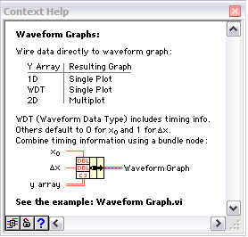
Graphs vs. Charts
Chart:
Remembers history – new point added to end of plot
Good for inside a loop
Graph:
New plot of all new data
Good for outside the loop
Use the Context Help window to determine how to wire multi-plot data to Waveform Graphs and XY Graphs
Notes:
Chart can be used outside a loop and Graphs can be used inside a loop. However, because of the update methods for charts and graphs, the are often used inside and outside loops, respectively.
If you place a graph inside a loop and send a new data point to it, only that data point will be plotted- not the entire history of data. You would have to build an array with each loop iteration and send the entire array to the graph in order to see the historical data with each loop iteration. This is commonly overlooked by new LabVIEW users.

Slide 15
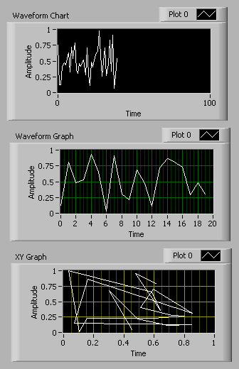
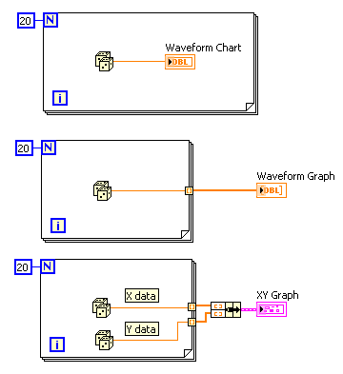
Graphs & Charts
Notes:
Notice that the Chart indicator is placed within the loop and the Graphs are outside the loop with auto-indexed tunnels. This is to reinforce the idea that graphs need arrays sent to them to see “complete” data where the chart will remember and display historical data, so only a single, new point is required to update the chart.

Slide 16
Chart Update Modes
Right-click the chart and select Advanced»Update Mode from the shortcut menu
Strip chart is the default update mode
Scope chart and Sweep chart modes display plots significantly faster than the strip chart mode
Notes:
Strip chart – once the right side of the plot area is reached, the next point added causes the entire plot to shift to the left, as if it were scrolling
Scope chart- once the right side of the plot area is reached, the next point added causes the plot to disappear and the new point is added to the far left side
Sweep chart- once the right side of the plot area is reached, the next point added causes the plot to remain and the new point is added to the far left side- a red bar shows where new data is overwriting the old data

Slide 17
Demonstration:
Comparing Graphs and Charts
Notes:
Introduction to LabVIEW Hands-On 24 ni.com

Slide 18
Error Handling
Anticipation, detection, and resolution of warnings and errors
Essential for:
Debugging - helps to catch programming errors
Stress testing - helps to test application boundary cases
Robustness - helps detect errors introduced by system and environment differences
Notes:
No matter how confident you are in the VI you create, you cannot predict every problem a user can encounter. Without a mechanism to check for errors, you know only that the VI does not work properly. Error handling tells you why and where errors occur.
Debugging: Error handling can help developers quickly pinpoint the source of their programming errors.
Stress testing: Error handling can help find the limits in an application by applying boundary conditions.
Robustness: Error handling can help detect differences in operating system, external files, etc.. This is particularly useful for applications after deployment.

Slide 19
Error Handling: Types
Automatic: if error out is left unwired, LabVIEW will handle it automatically (dialog box)
Manual: wiring the error out terminal means manual error handling is occuring- you decide what to do with the error.
Remember... without a mechanism to check for errors, you know only that the VI does not work properly
Notes:
Errors need to handled. If you wire the Error Out terminal, then you are telling LabVIEW that you will be handling it in some way (Manual Error Handling). If Error Out is left unwired, LabVIEW handles the error for you – by default, a dialog box will be generated and the VI’s execution will be paused. It is usually best to handle the error manually, because you can ensure your VI behaves as expected. For example, if an error occurs in the middle of a process, you can choose to either begin the process again or pick up where you left off.
Keep in mind that subVIs installed with LabVIEW typically do not execute if they receive an error, instead they pass the error through.

Slide 20
Errors vs. Warnings
Error
Status = TRUE
Warning
Status = FALSE
Code is non-zero
Notes:
There are both errors and warnings within LabVIEW. Most products and VI groups only have errors. Some products and VI groups have warnings. VISA is an example of a product group that has warnings.
Most error codes are negative values and warning codes are positive values; however, this is not universally true. A status of TRUE is always an error. A non-zero code with a status of FALSE is considered a warning.

Slide 21
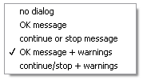
Error Handling: Functions
Simple Error Handler VI
creates a pop-up dialog box to notify user of error that has occurred
Configurable to handle warnings, too
Avoid using in subVIs
Merge Error VI
combines multiple error wires into a single error wire
error received on the top most input will be passed out, others will be ignored
Notes:
There are more functions than these two available to handle errors; though, these are the most commonly used.
The Simple Error Handle VI creates a pop-up window alerting the user of the error. You can configure the Simple Error Handler to catch warning or to specify the type of message that appears. Because this VI creates a pop-up window, it is best not to use it in a subVI. If the subVI is in a loop in the main VI and an error occurs within the subVI, you would see pop-up window after pop-up window as the loop continues to execute.
The Merge Error VI allows you to combine error wires into a single error wire keeping code clean. When using this VI, keep in mind that the top inputs take priority over lower ones with respect to the error that is passed out. Only one error is passed out.
Note: the Merge Error VI has changed its look in LabVIEW 2010 – it is now an expandable VI, no longer limited to four inputs.

Slide 22
Error Handling: Detection and Reporting
Use error wires to propagate errors along and handle appropriately
Merge errors from different wire paths
Notes:
The error wire is a great tool not only for ensuring errors are passed along, but also forcing order of execution. Most of the VIs in this slide have both a purple wire with the device ID as well as an error wire forcing execution, but this is not always the case. Sometimes the error wire will be the only data flow dependency between subVIs.
At the end of this block diagram, we can see a Merge Errors VI and a Simple Error Handler being used to capture any errors and display them to the user upon completion of the VI.

Slide 23
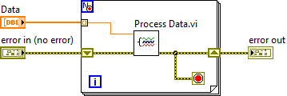
Error Handling: With Loops
Use shift-registers to detect errors and warnings in all loop iterations
Use error status as a condition to stop a loop
While Loops
Conditional For Loops
Notes:
This For Loop is using the conditional terminal to stop looping when an error occurs. The shift-registers will propagate warnings that might occur in the Process Data VI.
Most often, if an error occurs within a loop you would want to do something about the error as soon as possible. There is usually no purpose in continuing the loop iterations if an error has occurred. Therefore, having the conditional terminal be dependent on the error cluster status is a great way to ensure the loop exits if there is an error. An OR can be used if you want something other than an error occurring to stop the loop.
If shift registers were not used and Process Data.vi threw an error, it would be sent to the output tunnel and then possibly overwritten on the next iteration. You may never realize that there was an error in one iteration of the loop. Therefore, it is best to use shift registers to pass errors to subsequent loop iterations.

Slide 24
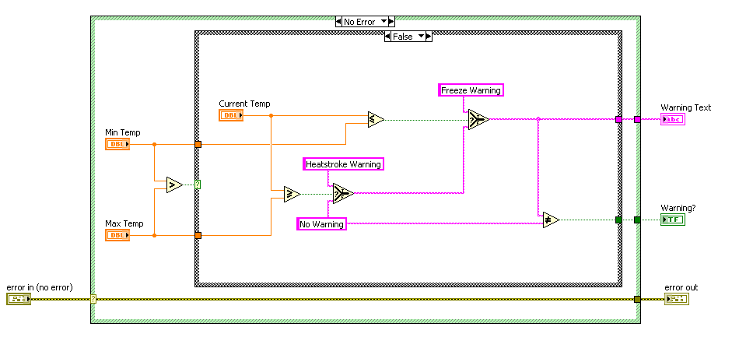
Handling Errors with SubVIs
Use a Case structure to handle errors passed into the subVI
Notes:
It is good practice to execute a subVI only if there is not an error passed to it. It is often a waste of time/resources if you run code when the data passed to that part of code was “bad” because some error occurred upstream. Putting a case structure around the code that makes up a subVI and wiring an error input cluster to the selector terminal is a great way to bypass the code if an error is passed to the subVI. In other words, leave the error case blank (with the exception of some constants wired to output so the tunnels have something wired to them in each case), so that if an error is passed into the VI the Error case will run (quickly) instead of the No Error case (which contains the subVI code).

Slide 25
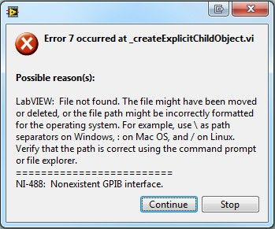
Error Code Ranges
Refer to the LabVIEW Help for complete list of error code ranges:
Fundamentals » Running and Debugging Vis » How-To » Error Codes and Messages » Ranges of LabVIEW Error Codes
Codes are subdivided into ranges according to product and VI grouping
Most codes are unique, but some error codes are used by more than one product or VI grouping
Notes:
Codes are subdivided into ranges according to product and VI grouping. For example, VISA error codes have different range than Analysis error codes.
Most codes are unique, but some error codes are used by more than one product or VI grouping. For example, error code 7 is both “File not found” and “Non-existent GPIB interface”. When this happens, both explanations are reported as shown in the image on the slide.

Slide 26
Debugging
Your VI isn’t broken, but you are getting unexpected data or behavior…
Any unwired or hidden subVIs?
Incorrect default data being used?
Undefined data being passed?
Numeric representation correct?
Node execution order correct?
Notes:
Debugging is what you do when your VI runs, but not correctly. You have to figure out why it is not running correctly. There are a number of tools/techniques you can use to help uncover the reason behind unexpected behavior or data.
The questions presented here represent a starting place to begin your troubleshooting.

Slide 27
Debugging Tools
use highlight execution
use probes to see the current value in the wire
set breakpoints to pause execution at a specific point in the code
single-step through the code
Notes:
Highlight execution, probes, breakpoints and single-stepping are four tools available in LabVIEW to help you determine why the VI is behaving differently than anticipated. Each is discussed in greater detail in the following slides

Slide 28
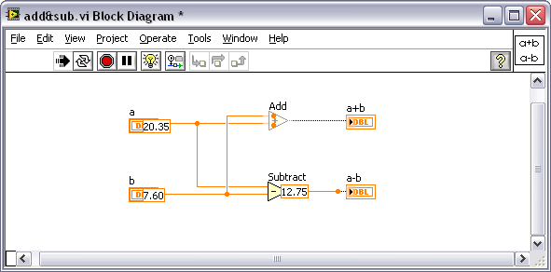
Debugging Tools: Highlight Execution
Use execution highlighting to watch the data flow through the block diagram
If the VI runs more slowly than expected, confirm that you turned off execution highlighting in subVIs
Notes:
Enable highlight execution by clicking the light bulb button on the block diagram’s toolbar. The light bulb will appear to light up when highlight execution is enabled.
Highlight execution slows down the execution of the block diagram and adds visual cues to the execution. You will see “data dots” moving along wires representing the flow of data between subVIs, functions, and structures. Output values will be displayed at output terminals in boxes colored to correspond with the datatype. Parts of the code that have not been executed will appear grayed out; parts that have already executed will have their normal, bright coloring.
Because highlight execution slows down the block diagram, it is not a valid tool for troubleshooting timing.

Slide 29
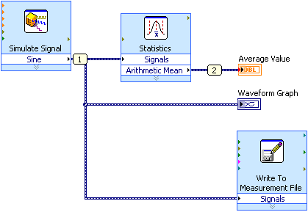
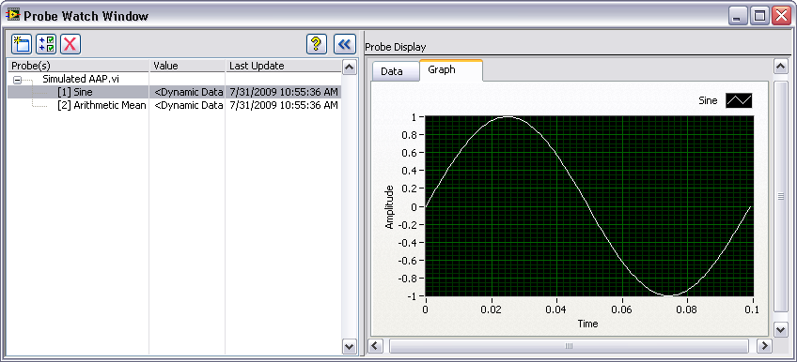
Debugging Tools: Probes
Use the Probe tool to
observe intermediate data values
check the error output of VIs and functions, especially those performing I/O
Values can be retained in the wires so that you can probe wires for data after execution has finished
Notes:
Probes can be created in edit and run mode.
If the VI is running, when you hover your mouse over a wire, your cursor will turn into a probe tool. Left-click on the wire to create a probe that will display (in the Probe Watch Widow) the value in that wire. [Note: LV 8.5 and earlier do not have probe watch windows- each probe is in a separate window]
If you are still editing the VI, you can add a probe to a wire by right-clicking on the wire and selecting Probe from the shortcut menu.
The Retain Wire Values button saves data values. When you click the Retain Wire Values button, LabVIEW saves the values at each point in the flow of execution so that when you place a probe on a wire, you can immediately obtain the most recent value of the data that passed through the wire. This debugging tool can impact the performance of your VI.

Slide 30
Debugging Tools: Breakpoints
When you reach a breakpoint during execution, the VI pauses and the Pause button appears red
You can take the following actions at a breakpoint:
Single-step through execution using the single-stepping buttons
Probe wires to check intermediate values
Change values of front panel controls
Click the Pause button to continue running to the next breakpoint or until the VI finishes running
Notes:
When a breakpoint is reached during execution, the VI will pause or “break.” It’s like programmatically pressing the pause button at a specific point in the code.
To create a breakpoint, right-click on the wire and select Breakpoint >> Set Breakpoint from the short cut menu (VI can be running or in edit mode). A red dot will appear on the wire and when it is “hit” the node that will execute next will blink.
One example of breakpoint use is: if you have a case structure and it seems like one of the cases is never being executed even though it should (in your mind), then put a breakpoint in the case in question. If the breakpoint is never hit, then the case never executed.
Breakpoints are also good to use if you have a complex VI and highlight execution would take far too long to follow (a loop with 20+ iterations, for example). Set a breakpoint, then turn on highlight execution or single step through the next part of the code you want to look at.

Slide 31
Debugging Tools: Single Stepping
Single-step through the VI to view each action of the VI on the block diagram
Suspend the execution of a subVI to
edit values of controls and indicators
control the number of times it runs
go back to the beginning of the execution of the subVI
Open subVI and select Operate»Suspend When Called from the shortcut menu
Notes:
Single-stepping allows you to determine the speed of execution because you tell LabVIEW when to make the next move.
Next to the pause button on the block diagram toolbar are three other buttons with gray arrows and yellow boxes- these are different variations of single stepping: step in, step over, step out.
If you are paused just before a subVI or a structure, stepping in means you will move into the subVI or stucture for the next step. If you were to step over, instead, the subVI or loop would execute at normal speed and then pause on the “other side”. If you had stepped in the subVI or loop and then realized that you don’t need to step through each part within the subVI or loop, you could step out, which means the rest of the subVI or loop would finish at full execution speed and then pause on the “other side.”
Step Into opens a node and pauses. When you click the Step Into button again, it executes the first action and pauses at the next action of the subVI or structure. You also can press the <Ctrl> and down arrow keys. (Mac OS) Press the <Command> and down arrow keys.
(Linux) Press the <Alt> and down arrow keys.
Step Over executes a node and pauses at the next node. You also can press the <Ctrl> and right arrow keys. (Mac OS) Press the <Command> and right arrow keys.
(Linux) Press the <Alt> and right arrow keys.
Step Out finishes executing the current node and pauses. When the VI finishes executing, the Step Out button becomes dimmed. You also can press the <Ctrl> and up arrow keys. (Mac OS) Press the <Command> and up arrow keys.
(Linux) Press the <Alt> and up arrow keys.

Slide 32
Homework
Debug and add error handling to the VI, “FixMe.vi”

