Slide 1


Welcome!
Workshop
1 of 7

Slide 2


Who am I?
Bogdan Doroslovac
Notes:
dilim.nwobu@ni.com
ni.com/tamu

Slide 3
Who are you?
Graduate or Undergraduate?
Engineering? A&S?
  EE
  BME
  ME
  CS
Heard of LabVIEW? Used LabVIEW?
Using LabVIEW for a project?

Slide 4
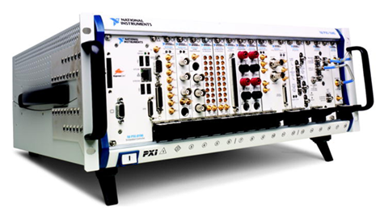
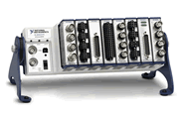



National Instruments
Leader in data acquisition technology with innovative modular instruments and LabVIEW graphical programming software
Corporate headquarters in Austin, TX
More than 40 international branches
5,100 employees
More than 1,000 products
600 Alliance Partners
Fortune’s 100 Best Companies to Work For Twelve Consecutive Years
Dr. James Truchard
Notes:
#6 on Forbes list of Most Loved CEOs
Wanted to start a company that focused on innovation in a fun and collaborative environment
GREAT corporate culture – CEO (and many others) where jeans daily. Razor scooters are used on the Applications Engineering floor to go from cube to cube. Everyone willing to help you. NI Volleyball league. Work hard, play hard!
© National Instruments Corporation 3 Introduction to LabVIEW Hands-On

Slide 5

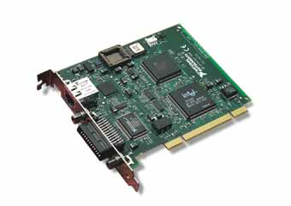

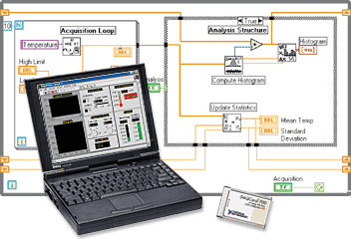
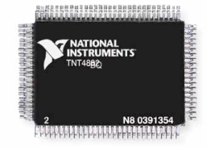
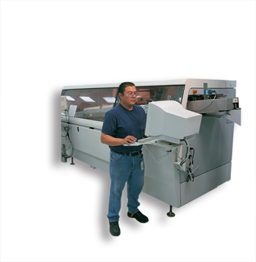




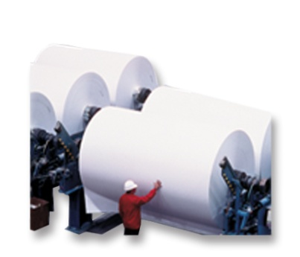
Diversity of Applications
No Industry > 10% of Revenue
Telecom
Automotive
Semiconductors
Electronics
Computers
ATE
Advanced
Research
Petrochemical
Food
Processing
Textiles
Military/Aerospace
Notes:
One of the reasons we’ve been able to weather adverse conditions relatively well is that we’re not tied to any particular industry. We make hardware and software for engineers and scientists useful to just about any company that makes things. Any group building something or inventing something requires testing to make sure that what they’re making is of good quality, or that they understand properties of things they’re trying to invent. They also might need some sort of automated control so they aren’t building things by hand. Our hardware and software measures and controls things like temperature, pressure, electrical properties, etc. to help ensure quality of products. Sometimes we do make products more aligned with particular industries, but for the most part, our products can be generically used across them, like Microsoft Office or personal computers.
© National Instruments Corporation 5 Introduction to LabVIEW Hands-On

Slide 6
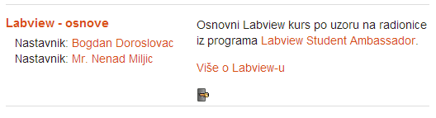
Moodle server:
http://147.91.26.131/moodle/
-> Labview – osnove -> Kreiraj novi…
Password: lv2012
Notes:
When you create an object on the front panel, a terminal is created on the block diagram. These terminals give you access to the front panel objects from the block diagram code.
Each terminal contains useful information about the front panel object it corresponds to. Such as, the color and symbols providing information about the data type. For example, the dynamic data type is a polymorphic data type represented by dark blue terminals. Boolean terminals are green with TF lettering.
In general, blue terminals should wire to blue terminals, green to green, and so on. This is not a hard-and-fast rule; you can use LabVIEW to connect a blue terminal (dynamic data) to an orange terminal (fractional value), for example. But in most cases, look for a match in colors.
Controls have a thick border and an arrow on the right side. Indicators have a thin border and an arrow on the left side. Logic rules apply to wiring in LabVIEW: Each wire must have one (but only one) source (or control), and each wire may have multiple destinations (or indicators).
Introduction to LabVIEW Hands-On 24 ni.com

Slide 7
Today's Topics
What is LabVIEW?
LabVIEW Environment
  LabVIEW Project
  Parts of a VI
  Menus & Palettes
  Configurations
LabVIEW Data Types
LabVIEW Data Flow

Slide 8
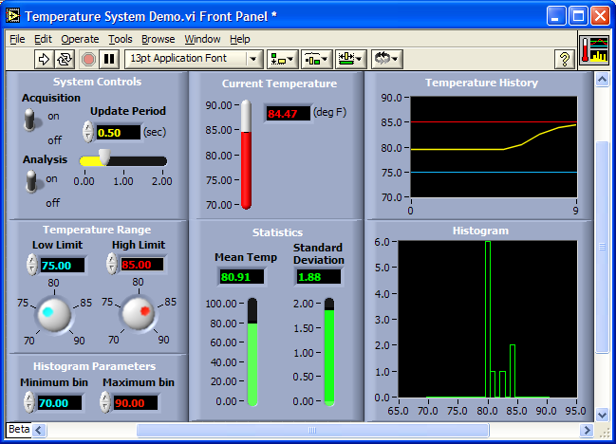
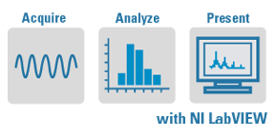
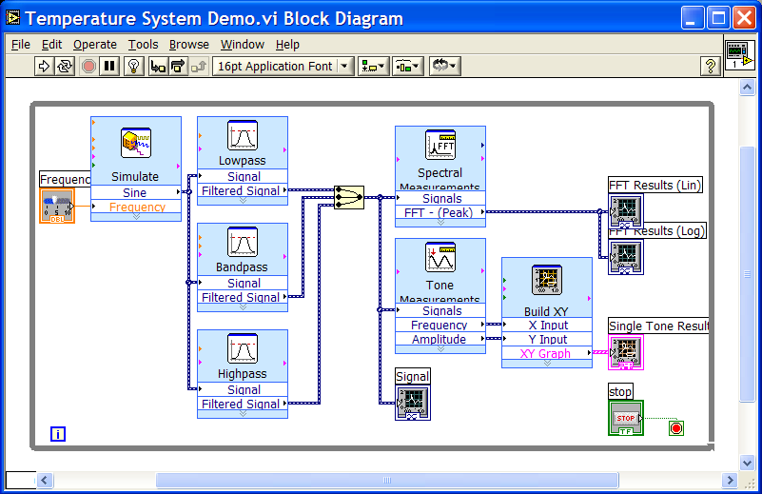
What is LabVIEW?
Laboratory Virtual Instrumentation Engineering Workbench
Compiled graphical development environment
Development time reduction of four to ten times
Tools to acquire, analyze, and present your data
Notes:
What is NI LabVIEW? LabVIEW is a highly productive graphical development environment with the performance and flexibility of a programming language, as well as high-level functionality and configuration utilities designed specifically for measurement and automation applications.
In general-purpose programming languages, the code is as much of a concern as the application. You must pay close attention to the syntax (commas, periods, semicolons, square brackets, curly brackets, round brackets, etc.). In contrast, with LabVIEW you use icons to represent functions, and you wire them together to determine the flow of data through your program, similar to creating flowcharts. It has all the breadth and depth of a general-purpose programming language, but it is easy to use, increasing your productivity by decreasing the time required to develop your applications.
You can easily divide measurement and automation application into three main parts: acquisition, analysis, and presentation of data. LabVIEW provides a seamless way to acquire your data, perform necessary analysis on that data, and present the information in a chosen format. Throughout the seminar, we touch upon each of these three components of a measurement and automation application.
Each program in LabVIEW is called a virtual instrument, or VI. The VI serves as the primary building block of a LabVIEW application, and you can use it to modularize your code for efficient design, clear and concise documentation, and simplified maintenance. Each LabVIEW VI is made up of three main components: the Front Panel, Block Diagram, and the Palettes.
In the coming slides, we continue our discussion of the actual development environment of LabVIEW.
© National Instruments Corporation LabVIEW Graphical Development Hands-On Seminar

Slide 9
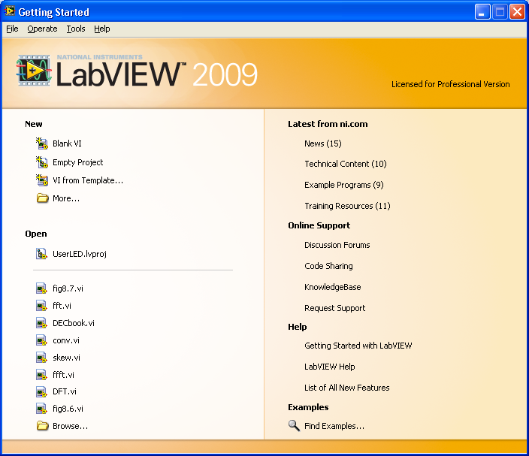
Open and Run LabVIEW
Start»All Programs»National Instruments LabVIEW 2009
»
Start from a blank VI:
New»Blank VI
Start from an example:
Examples»Find Examples…
or
Notes:
This is the screen you will see when LabVIEW is opened. From the Getting Started window you can do a number of things to begin development, including creating a new VI, a new project, or opening an example from the Example Finder. Other resources are available through quick links as well, such as online articles and forums. Recently opened files are also listed for easy access.
To create a new VI, you have a number of methods: (1) click the Blank VI link under New (2) go to File>>New VI (3) go to File >> New… and then select Blank VI in the outline/list. You can also create an empty project and create a VI from the project as described in the next slide.
LabVIEW Example Finder
LabVIEW features hundreds of example VIs you can use and incorporate into VIs that you create. In addition to the example VIs that are shipped with LabVIEW, you can access hundreds of example VIs on the NI Developer Zone (zone.ni.com). You can modify an example VI to fit an application, or you can copy and paste from one or more examples into a VI that you create.
© National Instruments Corporation 17 Introduction to LabVIEW Hands-On

Slide 10
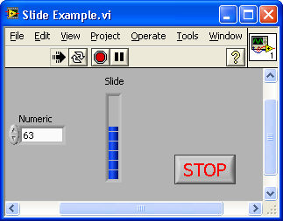

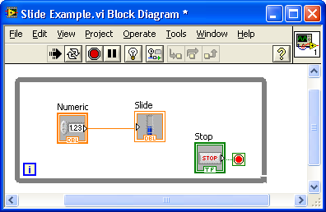
What is a Virtual Instrument (VI)?
Answer: a LabVIEW program
1. Front Panel
User interface (UI)
  Controls = inputs
  Indicators = outputs
2. Block Diagram
Graphical source code
  Data travels on wires from control terminals through functions to indicator terminals
  Blocks execute by data flow
3. Icon/Connector Pane
  Graphical representation of a VI
  Means of connecting VIs (subVIs)
* Conn. pane available from FP only
Notes:
LabVIEW programs are called virtual instruments (VIs).
Each VI contains three main parts:
Front panel – How the user interacts with the VI
Block diagram – The code that controls the program
Icon/connector – The means of connecting a VI to other Vis and the graphical representation of the VI
In LabVIEW, you build a user interface by using a set of tools and objects. The user interface is known as the front panel. You then add code using graphical representations of functions to control the front panel objects. The block diagram contains this code. In some ways, the block diagram resembles a flowchart.
You interact with the front panel when the program is running. You can control the program, change inputs, and see data updated in real time. Controls are used for inputs such as adjusting a slide control to set an alarm value, turning a switch on or off, or stopping a program. Indicators are used as outputs. Thermometers, lights, and other indicators display output values from the program. These may include data, program states, and other information.
Every front panel control or indicator has a corresponding terminal on the block diagram. When you run a VI, values from controls flow through the block diagram, where they are used in the functions on the diagram, and the results are passed into other functions or indicators through wires.
Double left-click to edit and customize Icon
Right-click to show other options (VI Properties, edit Icon, Show Connector)
Introduction to LabVIEW Hands-On 18 ni.com

Slide 11
Demonstration:
Creating a new VI
Notes:
When you create an object on the front panel, a terminal is created on the block diagram. These terminals give you access to the front panel objects from the block diagram code.
Each terminal contains useful information about the front panel object it corresponds to. Such as, the color and symbols providing information about the data type. For example, the dynamic data type is a polymorphic data type represented by dark blue terminals. Boolean terminals are green with TF lettering.
In general, blue terminals should wire to blue terminals, green to green, and so on. This is not a hard-and-fast rule; you can use LabVIEW to connect a blue terminal (dynamic data) to an orange terminal (fractional value), for example. But in most cases, look for a match in colors.
Controls have a thick border and an arrow on the right side. Indicators have a thin border and an arrow on the left side. Logic rules apply to wiring in LabVIEW: Each wire must have one (but only one) source (or control), and each wire may have multiple destinations (or indicators).
Introduction to LabVIEW Hands-On 24 ni.com

Slide 12
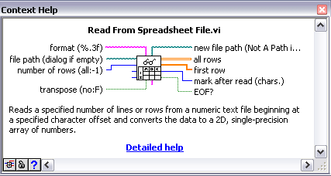
Front Panel Toolbar
It is best not to use the Abort button because you run the risk of not closing references or cleaning up memory correctly
Run
Run Continuously
Abort
Pause
Text Settings
Align Objects
Distribute Objects
Resize Objects
Reorder
Context Help
Notes:
Using the Abort button is not recommended because it does not allow your VI to properly finish.
Context Help is your friend! Use it! Context Help will provide information about whatever your mouse is hovering over (if the button in the bottom left hand corner of the Context Help window is in the Unlock position). You can get inputs/outputs of VIs including data types (indicated by the color of the wire) and a brief description of the function of the VI. The Detailed Help link or the blue ? Button (bottom left corner of Context Help window) will take you to LabVIEW’s Help file about that item. The button in the far bottom left corner of the Context Help window will show/hide optional input items.
The Run Continuously button is also used rarely- a loop should be used instead.
© National Instruments Corporation 19 Introduction to LabVIEW Hands-On

Slide 13
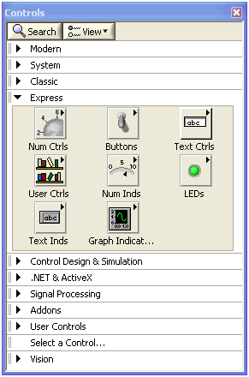
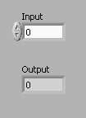

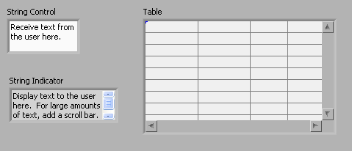
Front Panel Controls and Indicators
Numeric
Boolean
Customize Palette View
Right click!
String
Notes:
Controls and Indicators are the main items you will find on the front panel (decorations and free labels are examples of other possible items)
- Controls (Input): typically have white background (uninitialized arrays are an exception), numeric controls have the increment/decrement buttons showing by default. Controls can come in all shapes, sizes and types (i.e. numeric, boolean, string, array, cluster – switches, dials, tables)
- Indicators (Output): usually have a gray background and also come in all shapes, sizes, and types (gauges, LEDs, tanks)
Use the Controls palette to place controls and indicators on the front panel. The Controls palette is available only on the front panel and contains item that can be placed on the front panel. To view the Controls palette, right-click on the gray area of the front panel or select View»Controls Palette. Tack down the Controls palette by clicking the pushpin on the top left corner of the palette; customize the categories displayed by clicking the View Button and checking the categories you wish to view. *Recommendation* go to Tools>>Options>> Controls/Functions Palette and change the default setting to be Icons and Text for the display.
© National Instruments Corporation 19 Introduction to LabVIEW Hands-On

Slide 14
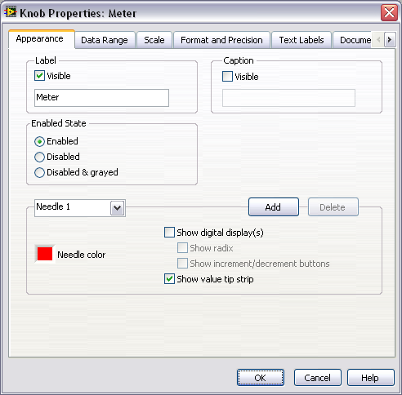
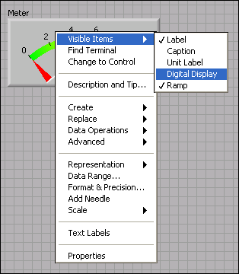
Shortcut Menus and Properties Dialog
Right Click!
Notes:
All LabVIEW objects have associated shortcut menus and you access the shortcut menu by right-clicking the object. Examples of things that can be done from the short cut menu are: selecting which aspects of the object is visible, change the object to a control or indicator, navigate to the related palette, change the representation (for numerics), change the display type (for strings, ie to hex display), access the properties window.
The properties window allows you to configure the object. Many of the commonly-changed properties are available from the short-cut menu. Properties include: color of the object, text on the object (buttons), representation (numerics), data range, descriptions.
Note: if multiple items are selected, the properties window will only display the properties shared amongst all of the objects. For example, if two numerics are selected and the properties window is opened, then it will be possible to set the data range. However, if a string and a numeric are selected, data range will not be available for changing because data range is not a property of a string.
Introduction to LabVIEW Hands-On 22 ni.com

Slide 15
Block Diagram Toolbar
Front Panel
Block Diagram
Run
Run Continuously
Abort
Pause
Highlight Execution
Retain Wire Values
Step In
Step Over
Step Out
Text Settings
Align Objects
Distribute Objects
Resize Objects
Reorder
Clean Up Block Diagram
Context Help
Notes:
The block diagram toolbar is very similar to the front panel with a few extras. Most important are:
Highlight Execution: slows down code execution and displays beads on the wires as data flows through them. Output values are also displayed in small boxes. Great tool for debugging (except when debugging timing issues- it slows the execution for you to visualize, so timing will not be correct)
Clean Up Block Diagram: arrange block diagram objects in an orderly fashion (according to data flow) and eliminates bends in wires. It’s not perfect, but it does a pretty good job. Note that it will take longer to clean up block diagrams with many objects
(note that the Context Help button is not displayed on the slide, but is present on the BD toolbar)
© National Instruments Corporation 19 Introduction to LabVIEW Hands-On

Slide 16
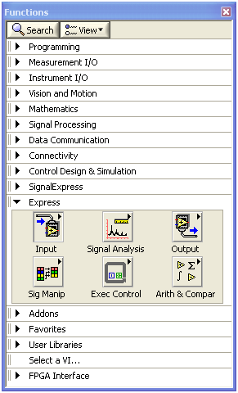


Block Diagram
Terminals
  Block Diagram appearance of front panel objects
  Entry & exit ports that exchange information between the front panel and block diagram
  Analogous to parameters and constants in text- based programming languages
Wires
  Transfer data between block diagram objects
  Wires are different colors, styles, and thicknesses, depending on data type
  A broken wire appears as a dashed
  black line with a red X in the middle
DBL Integer
Numeric Numeric String
Scalar
1D Array
2D Array
Notes:
Terminals:
Terminals are the connection to front panel objects. Two views: small icon and large icon (Tools>>Options to change the default view). The color represents the data type of the terminal. The terminals on this slide have a small arrow on the right side pointing out, which tells you that it is connected to a control (data comes from the terminal, out to the right) A terminal connected to an indicator will have an arrow on the left side pointing in (receives data from the wire to be sent to the front panel)
Wires:
Do not be afraid of broken wires! Hover over them with Context Help on and Context Help will tell you why the wire is broken (eg datatype mismatch)
Use the Functions palette to build the block diagram. The Functions palette is available only on the block diagram. To view the palette, select View»Functions Palette. You also can display the Functions palette by right-clicking an open area on the block diagram. Tack down the Functions palette by clicking the pushpin on the top left corner of the palette.
© National Instruments Corporation 19 Introduction to LabVIEW Hands-On

Slide 17
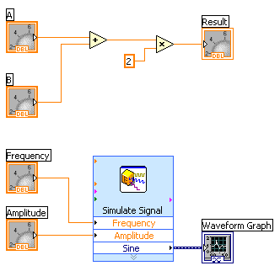
Data Flow
Block diagram execution is dependent on the flow of data
Block diagram does NOT execute left to right
Node executes when data is available to ALL input terminals
Nodes supply data to all output terminals when done
If the computer running this code had multiple processors, these two pieces of code could run independently without additional coding
Notes:
Introduction to LabVIEW Hands-On 26 ni.com
LabVIEW follows a dataflow model for running VIs. A block diagram node executes when all its inputs are available. When a node completes execution, it supplies data to its output terminals and passes the output data to the next node in the dataflow path. Visual Basic, C++, JAVA, and most other text-based programming languages follow a control flow model of program execution. In control flow, the sequential order of program elements determines the execution order of a program.
Consider the block diagram above. It adds two numbers and then multiplies by 2 from the result of the addition. In this case, the block diagram executes from left to right, not because the objects are placed in that order but because one of the inputs of the Multiply function is not valid until the Add function has finished executing and passed the data to the Multiply function. Remember that a node executes only when data are available at all of its input terminals, and it supplies data to its output terminals only when it finishes execution. In the second piece of code, the Simulate Signal Express VI receives input from the controls and passes its result to the graph.
You may consider the add-multiply and the simulate signal code to coexist on the same block diagram in parallel. This means that they begin executing at the same time and run independently of one another. If the computer running this code had multiple processors, these two pieces of code could run independently of one another (each on its own processor) without any additional coding.
It is good LV programming practice to have your program go from left to right, but data flow is not dependent on location of terminals or nodes on the block diagram.
Node executes when data is available to ALL input terminals
Nodes supply data to ALL output terminals when done (not before) - this includes loops! – a loop must completely finish all iterations before data will be passed out of its output tunnels.
Data flow being dependent on these two major rules allows independent sections of code to operate in parallel

Slide 18
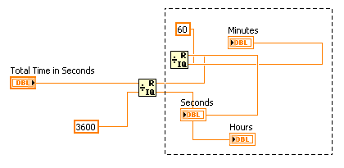
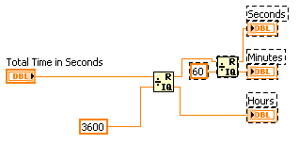
Block Diagram: Wiring Tips
Press <Ctrl>-B to delete all broken wires
Right-click and select Clean Up Wire to reroute the wire
  Use the Clean Up Diagram tool to reroute multiple wires and objects to improve readability
    Select a section of your block diagram
    Click the Clean Up Diagram button on the block diagram toolbar (or <Ctrl>-U)
Notes:
Note: Block diagram cleanup is only available in LV version 8.6 and later (2009, 2010 have partial block diagram clean up, which allows you to select a region to clean up as show in this slide)

Slide 19

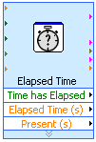
Block Diagram
Nodes
  Objects on the block diagram that have inputs and/or outputs and perform operations when a VI runs
  Analogous to statements, operators, functions, and subroutines in text-based programming languages
Functions
  Fundamental operating elements of LabVIEW
  Do not have front panels or block diagrams, but do have connector panes
  Double-clicking a function only selects the function – does not open it like a VI
  Has a pale yellow background on its icon
subVIs
  VI that you build to use inside another VI
  Any VI has potential to become a subVI
  Double-clicking a subVI will open it (exception: Express Vis- config. window opens)
  Icon represents subVI in main VI
Structures
  While loops, for loops, event structures
  More discussion later
Notes:
An express VI has a configuration window that pops up when you double click it. Values wired into an Express VI will override the configured setting (for example, if you configure the express vi to output a sine wave, then wire in a setting for a triangle wave, the express vi will output a triangle wave.
© National Instruments Corporation 19 Introduction to LabVIEW Hands-On

Slide 20
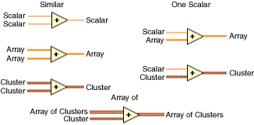
Polymorphism
Definition: a programming language feature that allows values of different data types to be handled using a uniform interface.
In LabVIEW: the ability of VIs and functions to automatically adapt to accept input data of different data types
  i.e. Numeric Functions
  Useful when performing the same operation on different data types
Notes:
In short, polymorphism is the ability of a node to accept/handle various data types.

Slide 21
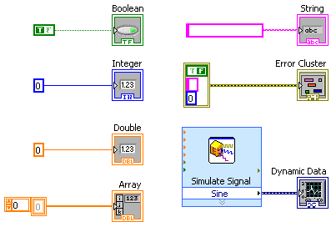
Common Data Types Found in LabVIEW
Notes:
LabVIEW uses many common data types:
Boolean, numeric, strings, clusters, and so on.
The color and symbol of each terminal indicate the data type of the control or indicator. Control terminals have a thicker border than indicator terminals. Also, arrows appear on front panel terminals to indicate whether the terminal is a control or an indicator. An arrow appears on the right if the terminal is a control and on the left if the terminal is an indicator.
Dynamic data is used in conjunction with Express VIs.
The LabVIEW User Manual on ni.com provides additional references for data types found in LabVIEW.
© National Instruments Corporation 25 Introduction to LabVIEW Hands-On

Slide 22
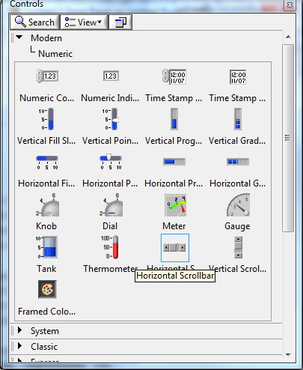
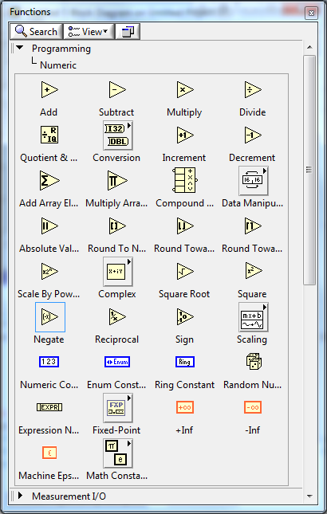
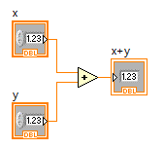
Numeric Controls and Functions
(Front Panel) From the Controls»Modern»Numeric subpalette, select the Numeric Control icon.
(Block Diagram) From the Functions»Programming»Numeric subpalette, select the Add icon.
Notes:
Arithmetic controls including numeric controls, vertical pointers, and knobs can be accessed through the Controls»Modern»Numeric subpalette and placed on the front panel. These controls are operated on by the numeric functions in the block diagram, which is accessed through the Functions»Programming»Numeric subpalette.
© National Instruments Corporation 65 Introduction to LabVIEW Hands-On

Slide 23
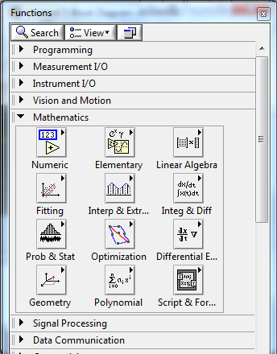
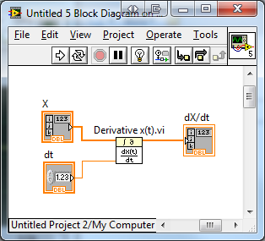
Mathematical Operations
(Block Diagram) From the Functions»Mathematics»Integration and Differentiation subpalette, select the Derivative x(t).vi
Notes:
Use the Mathematics VIs to perform many different kinds of mathematical analysis. You also can interface real-world measurements to the mathematical algorithms in order to obtain practical solutions. Mathematical analysis in LabVIEW include, but in not limited to, Linear Algebra, Interpolation, Integration and Differentiation, Optimization, etc.
© National Instruments Corporation 67 Introduction to LabVIEW Hands-On

Slide 24
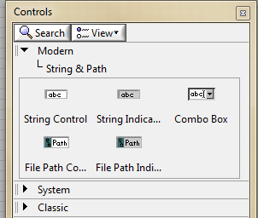
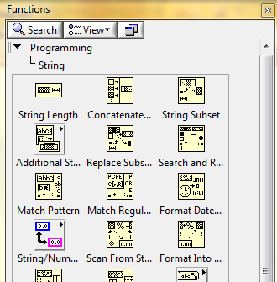
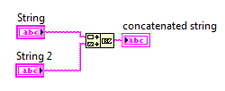
String Controls and Functions
(Front Panel) From the Controls»Modern»String subpalette, select the String Control icon.
(Block diagram) From the Function»Programming»String subpalette, select the Concatenate icon.
Notes:
© National Instruments Corporation 66 Introduction to LabVIEW Hands-On

Slide 25
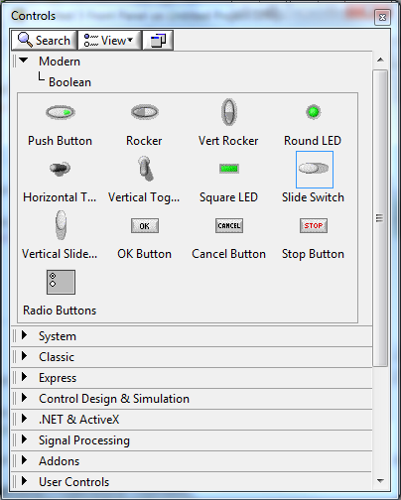
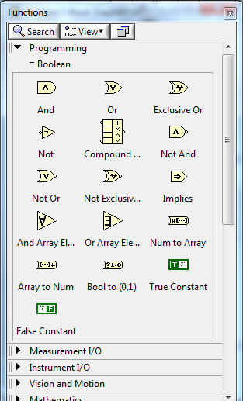
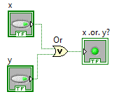
Boolean Controls and Functions
(Front Panel) From the Controls»Modern»Boolean subpalette, select the Push Button icon.
(Block diagram) From the Function»Programming»Boolean subpalette, select the OR icon.
Notes:
Boolean logic is also implementable in LabVIEW. From the front panel, you can access boolean controls, such as push buttons, toggle switches, and sliders and boolean indicators, such as LEDs. Boolean controls and indicators are found via the Controls»Modern»Boolean subpalette on the front panel. Boolean logic functions, such as AND, OR, and NOT functions, operate on these boolean controls. You can access the boolean functions on from the Function»Programming»Boolean subpalette on the block diagram.
© National Instruments Corporation 66 Introduction to LabVIEW Hands-On

Slide 26
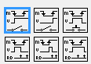
Mechanical Actions of Boolean Objects
Switch when pressed
Switch when released
Switch until released
Latch when pressed
Latch when released
Latch until released
Notes:
Play with the example VI : Mechanical Action of Booleans (search mechanical in the LV Example Finder, go to Help >>Find Examples)
Switch when pressed—Changes the control value each time you click it with the Operating tool, similar to a light switch. This behavior is not affected by how often the VI reads the control.
Switch when released—Changes the control value only after you release the mouse button during a mouse click within the graphical boundary of the control. This behavior is not affected by how often the VI reads the control.
Switch until released—Changes the control value when you click it and retains the new value until you release the mouse button. At this time, the control reverts to its default value, similar to the operation of a door buzzer. This behavior is not affected by how often the VI reads the control. You cannot select this behavior for a radio buttons control.
Latch when pressed—Changes the control value when you click it and retains the new value until the VI reads it once. At this point, the control reverts to its default value even if you keep pressing the mouse button. This behavior is similar to a circuit breaker and is useful for stopping a While Loop or for getting the VI to perform an action only once each time you set the control. You cannot select this behavior for a radio buttons control.
Latch when released—Changes the control value only after you release the mouse button within the graphical boundary of the control. When the VI reads it once, the control reverts to its default value. This behavior works in the same manner as dialog box buttons and system buttons. You cannot select this behavior for a radio buttons control.
Latch until released—Changes the control value when you click it and retains the value until the VI reads it once or you release the mouse button, depending on which one occurs last. You cannot select this behavior for a radio buttons control.

Slide 27
Purpose of Mechanical Actions of Booleans
Switch- like a light switch; stays at new value
Latch- like a circuit breaker; once the new value is read by LabVIEW, it returns to its old value.
Until Released Cases: Difference between Switch and Latch is that LabVIEW must read the new value for the Latch. For the switch, LabVIEW may not “see” the new value if the button press is very short . The latch will return to the old value only after LabVIEW reads it

Slide 28
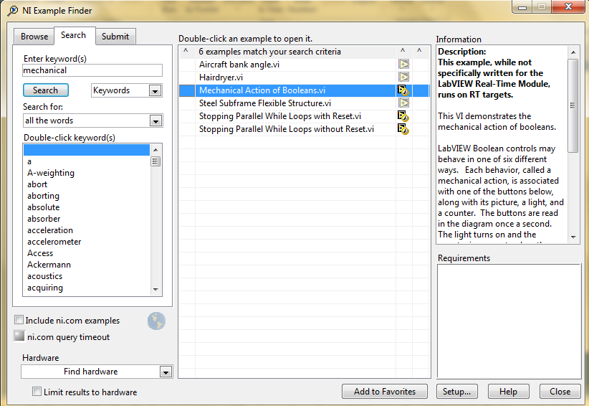
Mechanical Actions of Booleans Example
Open example in Example Finder:
Help» Find Examples…
Click Search tab
Type “mechanical”
Locate Mechanical
Action of Booleans
VI in search results
Notes:
Play with the example VI : Mechanical Action of Booleans (search mechanical in the LV Example Finder, go to Help >>Find Examples)
Switch when pressed—Changes the control value each time you click it with the Operating tool, similar to a light switch. This behavior is not affected by how often the VI reads the control.
Switch when released—Changes the control value only after you release the mouse button during a mouse click within the graphical boundary of the control. This behavior is not affected by how often the VI reads the control.
Switch until released—Changes the control value when you click it and retains the new value until you release the mouse button. At this time, the control reverts to its default value, similar to the operation of a door buzzer. This behavior is not affected by how often the VI reads the control. You cannot select this behavior for a radio buttons control.
Latch when pressed—Changes the control value when you click it and retains the new value until the VI reads it once. At this point, the control reverts to its default value even if you keep pressing the mouse button. This behavior is similar to a circuit breaker and is useful for stopping a While Loop or for getting the VI to perform an action only once each time you set the control. You cannot select this behavior for a radio buttons control.
Latch when released—Changes the control value only after you release the mouse button within the graphical boundary of the control. When the VI reads it once, the control reverts to its default value. This behavior works in the same manner as dialog box buttons and system buttons. You cannot select this behavior for a radio buttons control.
Latch until released—Changes the control value when you click it and retains the value until the VI reads it once or you release the mouse button, depending on which one occurs last. You cannot select this behavior for a radio buttons control.

Slide 29
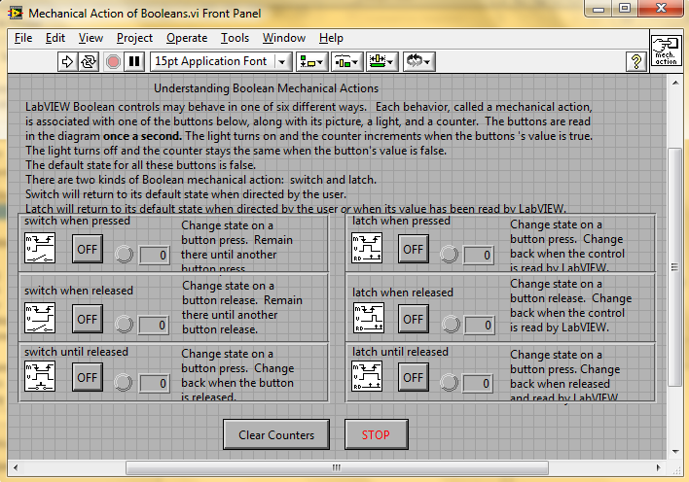
Mechanical Actions of Booleans Example
Notes:
Play with the example VI : Mechanical Action of Booleans (search mechanical in the LV Example Finder, go to Help >>Find Examples)
Switch when pressed—Changes the control value each time you click it with the Operating tool, similar to a light switch. This behavior is not affected by how often the VI reads the control.
Switch when released—Changes the control value only after you release the mouse button during a mouse click within the graphical boundary of the control. This behavior is not affected by how often the VI reads the control.
Switch until released—Changes the control value when you click it and retains the new value until you release the mouse button. At this time, the control reverts to its default value, similar to the operation of a door buzzer. This behavior is not affected by how often the VI reads the control. You cannot select this behavior for a radio buttons control.
Latch when pressed—Changes the control value when you click it and retains the new value until the VI reads it once. At this point, the control reverts to its default value even if you keep pressing the mouse button. This behavior is similar to a circuit breaker and is useful for stopping a While Loop or for getting the VI to perform an action only once each time you set the control. You cannot select this behavior for a radio buttons control.
Latch when released—Changes the control value only after you release the mouse button within the graphical boundary of the control. When the VI reads it once, the control reverts to its default value. This behavior works in the same manner as dialog box buttons and system buttons. You cannot select this behavior for a radio buttons control.
Latch until released—Changes the control value when you click it and retains the value until the VI reads it once or you release the mouse button, depending on which one occurs last. You cannot select this behavior for a radio buttons control.

Slide 30
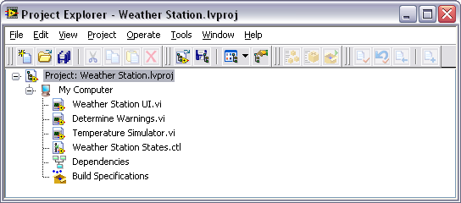
Project Explorer
Right Click!
Use LabVIEW Projects to:
  Group LabVIEW files and non-LabVIEW files
  Create build specifications (i.e. stand-alone applications)
  Deploy or download files to targets (i.e. FPGA target)
Notes:
The LabVIEW Project is the best way to keep your project organized and together. You can save a project with a unique name and will have a *.lvproj file extension. The project will show targets, such as My Computer. You can right click on the Project in the list (top item) and add a target by selecting New… Target and Devices from the shortcut menu. Targets are often connected to the host pc (My Computer) through a network. For more information on how to add a target to a project, check out ni.com’s knowledgebases.
Under a target will be the files hosted on that target. VIs are not the only type of file that can be in a project; custom controls, global variables, excel files, text files, word documents, and config files are a couple examples of other options. These files can be organized using Virtual Folders (right click on My Computer >> New>>Virtual Folder). Another option is an auto-populating folder, (R-click My Computer >> Add >> Folder (auto-populating). This will add files and folders within the folder you select and appear in the same organization as they are on disk. Therefore, if you move a file or create a folder on disk, the project will reflect those changes. [Auto-populating folders are only available for Windows, sorry!] When a file is added to a project, a pointer is created to that file- no copy is made.
A couple other things to note about a LV Project:
you can drag VIs from the project onto a block diagram to use that VI as a subVI. You can drag other LV items as well- such as global variables and custom controls.
Right –clicking on Build Specifications is the first step to building an executable from the VIs in your project. There are things to consider before building an executable such as programmatically quitting LabVIEW. However, Build Specifications is where the process of creating an EXE, installer, library, etc begins
- Dependencies will list all the subVIs for the VIs included in your project (including ones that ship with LV or are installed as part of a toolkit or driver)

Slide 31
When to use the Project Explorer
  Many subVIs or related files
  Will be creating an executable or distributing the files to others
  Using remote targets or shared variables
Notes:
The LabVIEW Project is the best way to keep your project organized and together. You can save a project with a unique name and will have a *.lvproj file extension. The project will show targets, such as My Computer. You can right click on the Project in the list (top item) and add a target by selecting New… Target and Devices from the shortcut menu. Targets are often connected to the host pc (My Computer) through a network. For more information on how to add a target to a project, check out ni.com’s knowledgebases.
Under a target will be the files hosted on that target. VIs are not the only type of file that can be in a project; custom controls, global variables, excel files, text files, word documents, and config files are a couple examples of other options. These files can be organized using Virtual Folders (right click on My Computer >> New>>Virtual Folder). Another option is an auto-populating folder, (R-click My Computer >> Add >> Folder (auto-populating). This will add files and folders within the folder you select and appear in the same organization as they are on disk. Therefore, if you move a file or create a folder on disk, the project will reflect those changes. [Auto-populating folders are only available for Windows, sorry!] When a file is added to a project, a pointer is created to that file- no copy is made.
A couple other things to note about a LV Project:
you can drag VIs from the project onto a block diagram to use that VI as a subVI. You can drag other LV items as well- such as global variables and custom controls.
Right –clicking on Build Specifications is the first step to building an executable from the VIs in your project. There are things to consider before building an executable such as programmatically quitting LabVIEW. However, Build Specifications is where the process of creating an EXE, installer, library, etc begins
- Dependencies will list all the subVIs for the VIs included in your project (including ones that ship with LV or are installed as part of a toolkit or driver)

Slide 32
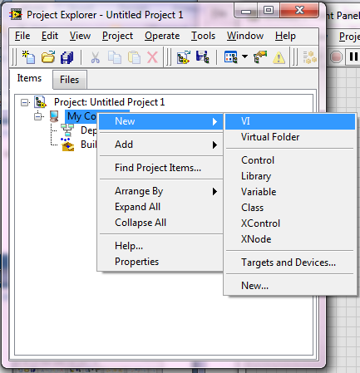
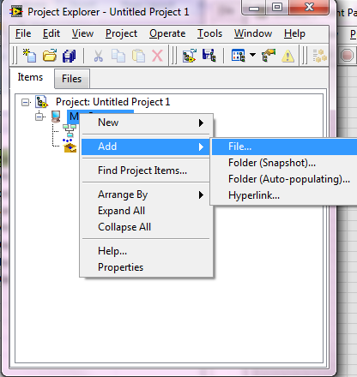
Project Explorer
  Can create new VI, virtual folder, control, library, variable, class, etc by right-clicking on My Computer >> New
  Can add an existing file or folder by right-clicking on My Computer >> Add
Notes:
The LabVIEW Project is the best way to keep your project organized and together. You can save a project with a unique name and will have a *.lvproj file extension. The project will show targets, such as My Computer. You can right click on the Project in the list (top item) and add a target by selecting New… Target and Devices from the shortcut menu. Targets are often connected to the host pc (My Computer) through a network. For more information on how to add a target to a project, check out ni.com’s knowledgebases.
Under a target will be the files hosted on that target. VIs are not the only type of file that can be in a project; custom controls, global variables, excel files, text files, word documents, and config files are a couple examples of other options. These files can be organized using Virtual Folders (right click on My Computer >> New>>Virtual Folder). Another option is an auto-populating folder, (R-click My Computer >> Add >> Folder (auto-populating). This will add files and folders within the folder you select and appear in the same organization as they are on disk. Therefore, if you move a file or create a folder on disk, the project will reflect those changes. [Auto-populating folders are only available for Windows, sorry!] When a file is added to a project, a pointer is created to that file- no copy is made.
A couple other things to note about a LV Project:
you can drag VIs from the project onto a block diagram to use that VI as a subVI. You can drag other LV items as well- such as global variables and custom controls.
Right –clicking on Build Specifications is the first step to building an executable from the VIs in your project. There are things to consider before building an executable such as programmatically quitting LabVIEW. However, Build Specifications is where the process of creating an EXE, installer, library, etc begins
- Dependencies will list all the subVIs for the VIs included in your project (including ones that ship with LV or are installed as part of a toolkit or driver)

Slide 33
Demonstration:
Adding Folders and Files to a Project
Notes:
Introduction to LabVIEW Hands-On 24 ni.com

Slide 34
Demonstration :
Using the Functions and Controls Palette
Notes:
Explore the palettes;
add controls/indicators to the front panel;
align objects using the buttons on the toolbar;
show how to pin down the palettes and search for items in the palettes
Introduction to LabVIEW Hands-On 24 ni.com

Slide 35
Demonstration 1:
Creating a simple VI
Notes:
- Create a new VI from the project to show that the Project keeps track of the Vis you create
- Build a VI that represents the slope formula – multiplying two numbers and adding another
- Demonstrate clean up block diagram and highlight execution to show data flow
Introduction to LabVIEW Hands-On 24 ni.com

Slide 36
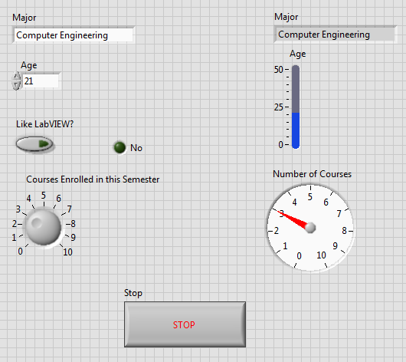
Exercise
Create a new VI with a front panel block diagram that looks like this one:
Notes:
This is to practice navigating the LabVIEW environment- adding things to the front panel and block diagram, aligning and resizing objects
Introduction to LabVIEW Hands-On 24 ni.com

Slide 37
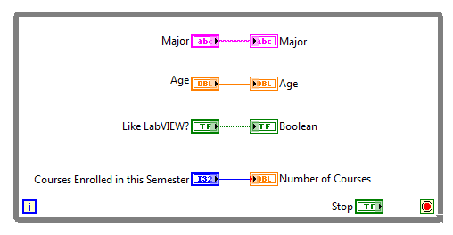
Exercise
Create a new VI with a front panel block diagram that looks like this one:
Notes:
This is to practice navigating the LabVIEW environment- adding things to the front panel and block diagram, aligning and resizing objects
Introduction to LabVIEW Hands-On 24 ni.com

Slide 38
Quiz 1
Notes:
- Create a new VI from the project to show that the Project keeps track of the Vis you create
- Build a VI that represents the slope formula – multiplying two numbers and adding another
- Demonstrate clean up block diagram and highlight execution to show data flow
Introduction to LabVIEW Hands-On 24 ni.com

Slide 39
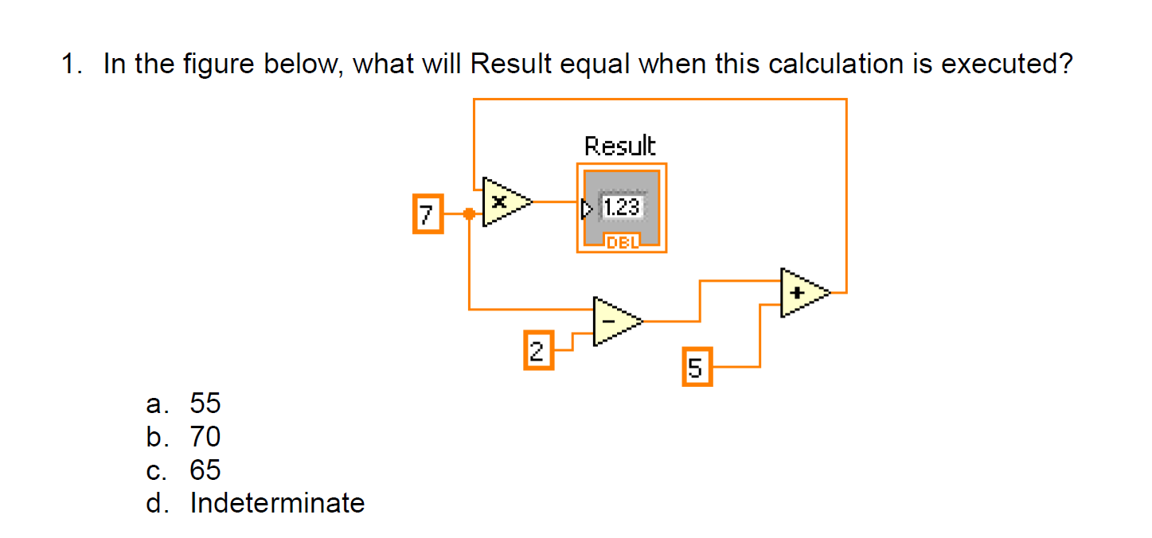

Slide 41
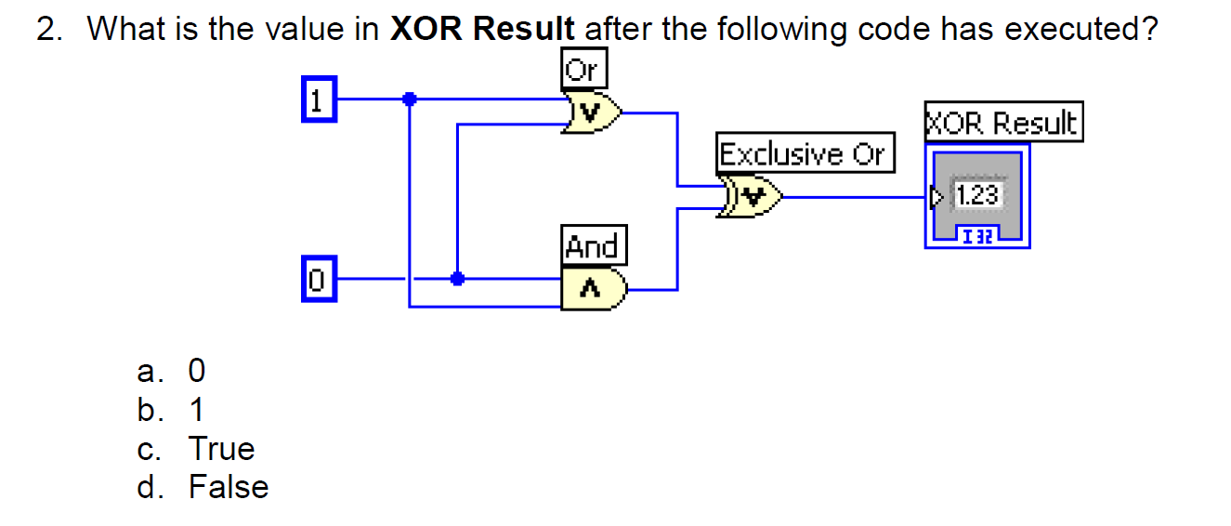

Slide 43
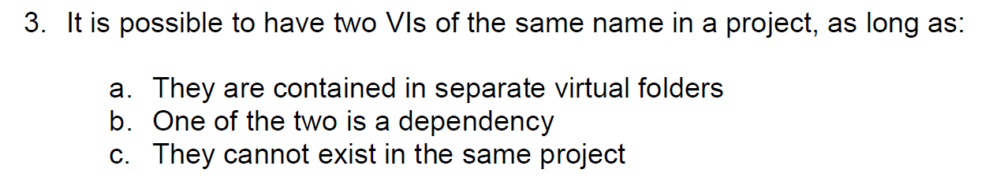

Slide 45
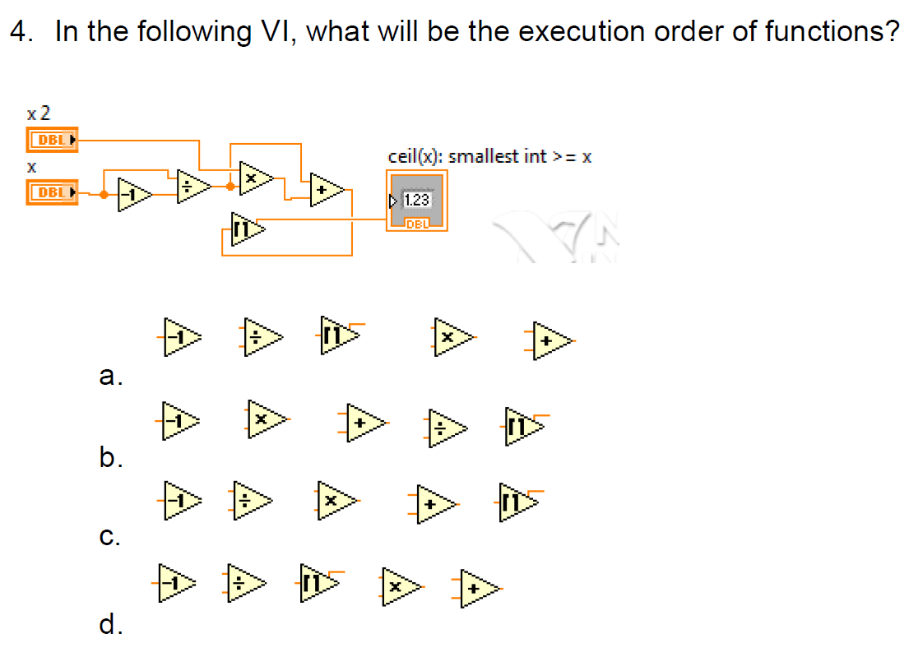

Slide 47


Slide 49



Slide 51


