Slide 1
Welcome!
Workshop
4 of 7

Slide 2
Today's Topics
Review of Workshop 3
Sequence Structure
Timing
State Machine

Slide 3
Review Question 1
How many times must a For Loop iterate? A While Loop?
0,0
1,0
0,1
1,1

Slide 4
Review Question 1
How many times must a For Loop iterate? A While Loop?
0,0
1,0
0,1
1,1
Notes:
A for loop can execute 0 times if a 0 is wired to N
A while loop must run at least once in order to read the value wired into the conditional terminal.

Slide 5
Review Question 2
True or False?
The value passed to the case selector terminal determines which case will execute.

Slide 6
Review Question 2
True or False?
The value passed to the case selector terminal determines which case will execute.
TRUE
Notes:
The case selector terminal is identified by a question mark inside the box. The value that is wired to it (can be string, boolean, numeric, enum, etc) will determine which case will run.

Slide 7
Review Question 3
A “hollow” output tunnel will appear on the edge of a case structure because…?
the wrong data type is wired to it
there is not a wire leading away from it
one or more cases do not have a wire leading to it

Slide 8
Review Question 3
A “hollow” output tunnel will appear on the edge of a case structure because…?
the wrong data type is wired to it
there is not a wire leading away from it
one or more cases do not have a wire leading to it
Notes:
Every case must have a wire leading to an output tunnel on a case structure. The only exception to this rule is if Use Default if Unwired is enabled (however, it is recommended to use a wire explicitly for clarity)

Slide 9
Review Question 4
Which of the following statements about Auto-indexing are true? (multiple answers possible)
When auto-indexing is enabled on an output tunnel, only one element can be passed out of the tunnel.
When auto-indexing is enabled on an input tunnel, only one element can be passed out of the tunnel
When auto-indexing is enabled on an output tunnel, the entire array is passed out of the tunnel
When auto-indexing is enabled on an input tunnel, the entire array is passed out of the tunnel

Slide 10
Review Question 4
Which of the following statements about Auto-indexing are true? (multiple answers possible)
When auto-indexing is enabled on an output tunnel, only one element can be passed out of the tunnel.
When auto-indexing is enabled on an input tunnel, only one element can be passed out of the tunnel
When auto-indexing is enabled on an output tunnel, the entire array is passed out of the tunnel
When auto-indexing is enabled on an input tunnel, the entire array is passed out of the tunnel
Notes:
Auto-indexing on an input tunnel will pass one element of the array into the loop sequentially. It will also determine the number of times a for loop can iterate. If auto-indexing is disabled, the entire array will be passed into the loop with each loop iteration.
Auto-indexing on an output tunnel will means the values sent to the auto-indexed output tunnel during each loop iteration will accumulate at the tunnel and be passed out as an array when the loop finishes executing. If auto-indexing is disabled, then only the most recent value will be passed out.

Slide 11
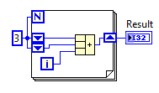
Review Question 5
The value of Result when the VI below finishes will be:
15
18
22
28

Slide 12
Review Question 5
The value of Result when the VI below finishes will be:
15
18
22
28
Notes:
Iterates 3 times because 3 is wired to N.
1st iteration:
i= 0
Top shift register = 3
Bottom shift register = 3
Sum sent to right shift register = 6
2nd iteration:
i= 1
Top shift register = 6
Bottom shift register = 3
Sum sent to right shift register = 10
3rd iteration:
i= 2
Top shift register = 10
Bottom shift register = 6
Sum sent to right shift register = 18

Slide 13
Flat Sequence Structure
Executes each frame beginning with the left-most frame and ending with the right-most frame
The previous frame must complete before the next frame executes
Data can be passed out of or between frames using tunnels
Once the sequence begins, it cannot be stopped
1st
2nd
3rd
Notes:
A sequence structure contains one or more subdiagrams, or frames, that execute in sequential order. Within each frame of a sequence structure, as in the rest of the block diagram, data dependency determines the execution order of nodes. Sequence structures are not used commonly in LabVIEW. Use the sequence structures to control the execution order when natural data dependency does not exist and flow-through parameters are not available.
Flat Sequence Structure
Use the Flat Sequence structure to avoid using sequence locals and to better document the block diagram. When you add or delete frames in a Flat Sequence structure, the structure resizes automatically.
Each frame will send its outputs on the completion of that frame (this is different than the stacked sequence structure). The outputs may go to the next frame or external to the sequence structure.
The sequence structure cannot be stopped in the middle, which is why it is not often used.

Slide 14
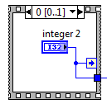
Stacked Sequence Structure
Stacks each frame so you see only one frame at a time
Executes frame 0, then frame 1, etc. until the last frame executes
Returns data only after the last frame executes
To transfer data from frame to frame, a Sequence Local must be created (right-click » Add Sequence Local)
Once the sequence begins, it cannot be stopped
Sequence Local
Notes:
To convert a Flat Sequence structure to a Stacked Sequence structure, right-click the Flat Sequence structure and select Replace with Stacked Sequence from the shortcut menu. If you change a Flat Sequence to a Stacked Sequence and then back to a Flat Sequence, LabVIEW moves all input terminals to the first frame of the sequence. The final Flat Sequence should operate the same as the Stacked Sequence. After you change the Stacked Sequence to a Flat Sequence with all input terminals on the first frame, you can move wires to where they were located in the original Flat Sequence.
Stacked Sequence Structure
The Stacked Sequence structure returns data only after the last frame executes. Use the Stacked Sequence structure if you want to conserve space on the block diagram.
To convert a Stacked Sequence structure to a Flat Sequence structure, right-click the Stacked Sequence structure and select Replace»Replace with Flat Sequence from the shortcut menu. The sequence selector identifier, shown as follows, at the top of the Stacked Sequence structure contains the current frame number and range of frames.

Slide 15
Timing Functions
Control or measure the frequency at which a loop executes
Provide the processor with time to complete other tasks, such as processing the user interface
Uses the operating system millisecond clock
Notes:
There are many reasons to use the timing functions. The Wait and Wait Until Next Millisecond Multiple functions are used for two main reasons: to control loop frequency (how quickly you go to the next loop iteration) and to provide “down time” for the processor allowing it to go complete other (possibly non-LabVIEW) tasks, such as updating the front panel or run a virus scan. The Elapsed Time Express VI is used to check how much time is passed. The Tick Count and Get Date/Time In Seconds functions can be used to determine how much time has passed, as well, by taking the difference of two measurements. (Note that the Tick Count has a maximum value 4,294, 967, 295 because it is limited by the data type, U32. Once the maximum is reached, it begins again at zero: also known as rolling over. Therefore, if you want to measure a longer time, use the Get Date/Time in Seconds.)
The timing functions use the Operating System’s ms clock
The wait and wait until next ms multiple functions are discussed in the following slides in more detail.

Slide 16
Wait Function
Waits the specified number of milliseconds.
If 0 is wired to it, the current thread is forced to yield control of the CPU
Uses the operating system millisecond clock
Notes:
The wait simply waits the number of ms wired into it. When in a loop, it often has nothing forcing its execution (other than the constant wired to it) relative to the other code within the loop. Therefore, the Wait function will operate in parallel with the other code in the loop. If the other code takes a shorter amount of time to execute, the wait will continue until it has met the value wired to it before allowing the next loop iteration. If the wait takes a shorter time, then the next loop iteration will begin directly after the other code in the loop finishes. This is shown in the next slide.

Slide 17
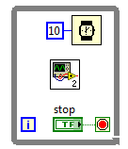
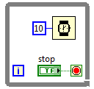
Wait Function- example cases
Loop would go to next iteration after 10 ms or more depending on amount of time the subVI takes.
If subVI takes >10 ms, loop goes as soon as subVI is done
If subVI takes <10 ms , loop goes at 10 ms mark.
Loop would go on to next iteration after 10 ms, because the only thing that happens in each iteration is wait 10 ms
Moment next loop iteration can begin
Wait
Other code (running in parallel with Wait VI)
10 ms
20 ms
30 ms
Notes:
The wait simply waits the number of ms wired into it. When in a loop, it often has nothing forcing its execution (other than the constant wired to it) relative to the other code within the loop. Therefore, the Wait function will operate in parallel with the other code in the loop. If the other code takes a shorter amount of time to execute, the wait will continue until it has met the value wired to it before allowing the next loop iteration. If the wait takes a shorter time, then the next loop iteration will begin directly after the other code in the loop finishes.
The green shapes show the point at which the next loop iteration would begin if the other code (blue line) took 16 ms: right at 16 ms for the wait function because the value wired into the wait is less than the time the other code took to execute

Slide 18
Wait Until Next Millisecond Multiple Function
Waits until a multiple of the millisecond value wired in
Provide the processor with time to complete other tasks, such as processing the user interface
Uses the operating system millisecond clock
Notes:
The wait until next ms multiple sets up “opportunities” when the code is allowed to continue. For example, consider a situation where there is a loops with a wait until next ms multiple inside the loop along with other code and there is a 10 (ms) wired into the wait until next ms multiple function. If the other code in the loop finishes after 8ms, then the wait until next ms multiple will wait an additional 2ms (total of 10ms) before the next loop iteration is allowed to execute because the first opportunity is at 10ms (first multiple of 10; 10x1). If the other code take 13ms to complete, then the next loop iteration cannot begin until the 20 ms mark (second multiple of 10ms; 10x2).
If 15 were wired into the wait until next ms multiple instead of 10, then the times when the next loop iteration could happen would be at the 15, 30, 45, 60….. ms marks; (multiples of 15)

Slide 19
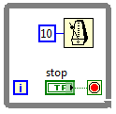
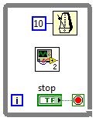
Wait Until Next Millisecond Multiple Function
Loop would go to next iteration after 10 , 20, 30, or a greater multiple of 10 ms depending on amount of time the subVI takes.
If subVI takes <10 ms , loop goes at 10 ms mark.
If subVI takes 16 ms, then the loop goes at 20 ms.
If subVI takes 22 ms, then the subVI goes at 30 ms.
Loop would go on to next iteration after 10 ms, because the only thing that happens in each iteration is wait 10 ms and 10ms is the first multiple of 10
Wait
Other code (subVI)
10 ms
20 ms
30 ms
Notes:
There are two main reasons to use the timing functions: to control loop frequency (how quickly you go to the next loop iteration) and to provide “down time” for the processor allowing it to go complete other (possibly non-LabVIEW) tasks, such as updating the front panel or check for email.
The timing functions use the Operating System’s ms clock
The wait simply waits the number of ms wired into it. When in a loop, it often has nothing forcing its execution (other than the constant wired to it) relative to the other code within the loop. Therefore, the Wait function will operate in parallel with the other code in the loop. If the other code takes a shorter amount of time to execute, the wait will continue until it has met the value wired to it before allowing the next loop iteration. If the wait takes a shorter time, then the next loop iteration will begin directly after the other code in the loop finishes.
The wait until next ms multiple sets up time markers when the code is allowed to continue. For example, consider a situation where there is a loops with a wait until next ms multiple inside the loop along with other code and there is a 10 (ms) wired into the wait until next ms multiple function. If the other code in the loop finishes after 8ms, then the wait until next ms multiple will wait an additional 2ms (total of 10ms) before the next loop iteration is allowed to execute. If the other code take 13ms to complete, then the next loop iteration cannot begin until the 20 ms mark (an interval of 10ms). If 15 were wired into the wait until next ms multiple instead of 10, then the times when the next loop iteration could happen would be at the 15, 30, 45, 60….. ms marks.
The green shapes show the point at which the next loop iteration would begin if the other code (blue line) took 16 ms: right at 16 ms for the wait function (because the value wired into the wait is less than the time the other code took to execute) and 20 ms for the wait until next ms multiple function (because the loop can only go to the next iteration at multiples of 10ms)

Slide 20
Comparison of Timing Functions
Red represents times when Wait functions are NOT restricting
Moment next loop iteration can begin
Other code (running in parallel with waits)
10 ms
20 ms
30 ms
Notes:
This slide is to visualize the different behavior from the Wait and the Wait Until Next Millisecond Multiple functions.
Assumptions: The “other code,” such as a subVI, is running in parallel with either Wait or Wait Until Next Millisecond Multiple, which are within a loop. (The concept holds for other structures, like a case structure, but is easiest to understand and most often used within a loop)
Definitions:
green star: the point at which the next loop iteration would begin
Blue solid line: time when the “other code” is executing.
Black solid line (horizontal): time when Wait is executing
Red: times when Wait functions are NOT restricting
If the other code (blue line) took 16 ms….
…a loop with the Wait functions would go to the next iteration right at 16 ms because the value wired into the wait is less than the time the other code took to execute. [the blue line finishes within the red area for the Wait]
… a loop with Wait Until Next Millisecond Multiple function would go to the next iteration at 20 ms because the loop can only go to the next iteration at multiples of 10ms and 20 is the next multiple of 10. [the blue line finishes between red dots for the Wait Until Next Millisecond Multiple and the loop can’t go until the next red dot, so the loop waits an additional 4ms until the 20 ms mark]

Slide 21
Demonstration:
Comparing the Timing Functions
Notes:
- Create a subVI - Edit the Icon - Wire Connector Pane -
Introduction to LabVIEW Hands-On 24 ni.com

Slide 22
VI Timing Types
Execution Timing
Provides the design pattern with a function that specifically allows the processor time to complete other tasks
In some cases, a Wait function is not necessary
Use of Timeout inputs can provide execution timing
Software Control Timing
Timing (pauses, waits, time checks) you put in place to make the code execute after a certain amount of time.
Example:
If you must acquire data for 5 minutes, you could remain in the acquisition state until the 5 minutes elapses. However, during that time you cannot process any user interface actions such as stopping the VI. To process user interface actions, you must implement timing (checking if 5 min has passed since the start of acquisition) so that the VI continually executes for the specified time
Notes:
Execution timing, in general, is something that releases the processor. This could be a timeout (we will see this later with event structure) or a wait function placed in a while loop. Allowing the processor to complete other tasks, may actually speed up your code, which is counterintuitive because it seems like adding a wait would slow down code.
Software Control Timing is when you want the code to execute at/after certain amounts of time. For example, if you are controlling a car wash, you would want the soap cycle to be 1 min long and the rinse cycle to be 3 min long, then you will need to put in some timing code to ensure the time goals are met. Another example is you want to acquire data for 7.3 seconds, you will need to add code to make sure the acquisition doesn’t stop prematurely or last longer. In summary, you don’t want the code to simply execute as fast as it can, so you implement software control timing.

Slide 23
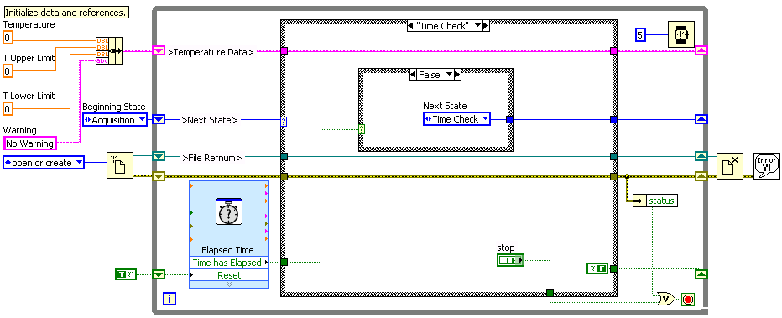
VI Timing
Execution Timing
Software Control Timing
Notes:
The software control timing is checking to see if X amount of time has elapsed and then using a case structure so when enough time has elapsed (True) something other than checking the time again (false) will happen
The wait in the upper corner of the while loop is allowing the processor to rest and complete other tasks before executing the next loop iteration.

Slide 24
State Machine Intro: Scenario
Want to create a program that does the following:
Reads a voltage
Tells user to turn on power supply
Read the voltage again now that power is on
Tell the user to turn off the power.

Slide 25
Programming Designs: Sequential
Notes:
This might be the first attempt at meeting the program requirements. However, what do you recognize to be the issue with this one? (hint: think data flow)……….yep, there’s nothing forcing execution order.

Slide 26
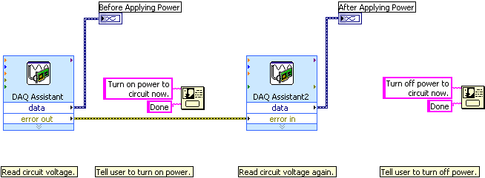
Sequential Programming
Notes:
You may add an error wire to force the DAQ Assistant 2 to operate after DAQ Assistant 1. However, there is still nothing forcing the dialog VIs to operate when you want them.

Slide 27
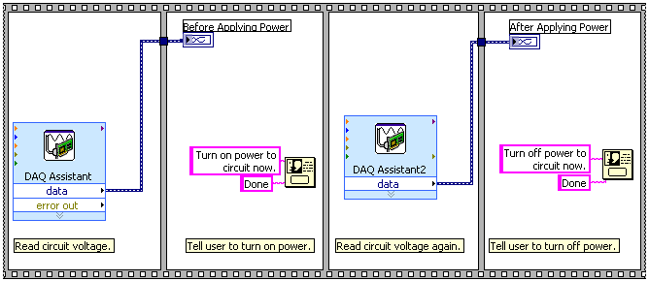
Sequential Programming
Notes:
You may think: Well, I remember the sequence structure forces execution order. I know that this VI will operate in the order I want.
However, I am supposed to use sequence structures on a limited basis.

Slide 28
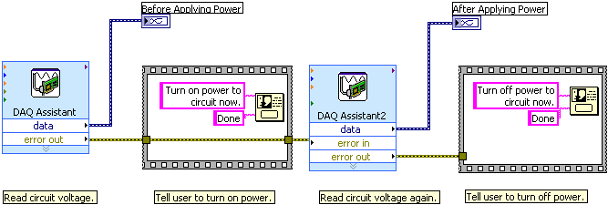
Sequential Programming
Notes:
Ok. The sequence structure is limited, the order of execution will occur properly.
Problem: this code is limited still. Consider the questions on the following slide…..

Slide 29
Sequential Programming
What if you need to change the order of the sequence?
What if you need to repeat one item in the sequence more often than the other items?
What if some items in the sequence execute only when certain conditions are met?
What if you need to stop the program immediately, rather than waiting until the end of the sequence?

Slide 30
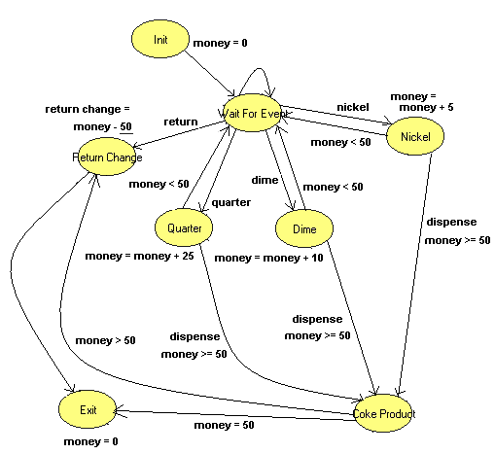
State Machines
Implements a state diagram.
Programmatically determine which state is next
Different action if a quarter was inserted compared to return change requested
Notes:
A state machine implements a state diagram in LabVIEW. This state diagram outlines the various states and transitions associated with a vending machine. We know that controlling a vending machine is not a linear process because we need to react to the user actions. Did they put in a quarter? Then add $0.25 to the total. Did they put in a nickel then a quarter? Then add $.05 before adding $0.25. The order in which things are done is not always the same, thus a linear program does not meet our needs. The state machine allows you to perform tasks in a different order based on the current needs. Some steps may be skipped (what if they never use a dime?) others may be repeated many times (waiting for the next coin).

Slide 31
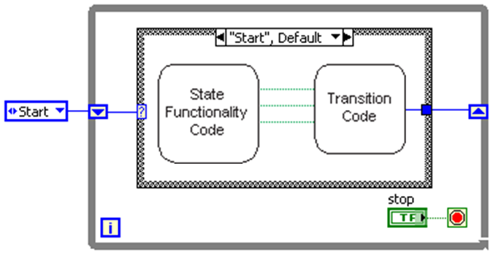
State Machine
A state machine consists of a set of states and a transition function that maps to the next state
Each state can lead to one or multiple states or end the process flow
While Loop
Enum
Shift Register
Case Structure
Notes:
Solution: the State Machine.
The state machine design pattern implements a state diagram or flow chart. It goes from a state (usually initialize), through a transition (decision), to another state, and can continue this way until the end state is reached.
Fundamental parts of a state machine:
While loop – this allows the code to go from state to state indefinitely- until the conditional terminal condition is met (may be a shutdown state that sends a true to the conditional terminal)
Case structure – this allows various states to be options and holds the code to be executed in each state.
Shift register – this allows one state to pass the “next state” to the selector on the next loop iterations, therefore going to the next state. The value passed into the left side of the shift register from outside the loop is the first state (Start in this example) that will be executed – it is initializing the shift register.
Enum (not required, but often used) – an enum with a list of states is often used because it reduces the risk of typos, and when type def’d an additional state can easily be added to the enum’s item list as well as the cases of the case structure.
When to use state machines?
Commonly used to create user interfaces, where different user actions (pressing a button, flipping a switch, changing a numeric value) send the user interface into different states
Commonly used for process tests, where a state represents each segment of the process

Slide 32
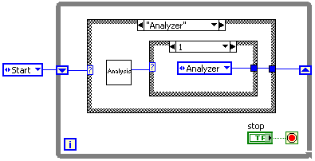
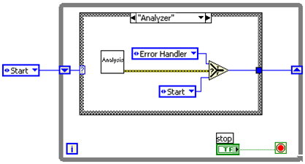
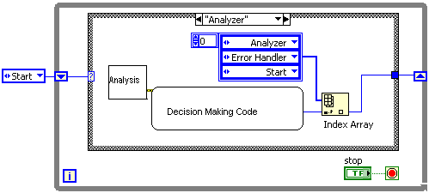
State Machine: Transition Code
State Functionality Code:
this state was entered to perform what function?
Transition Code:
which state is next?
Notes:
There are two main parts of the code in each state of a state machine:
State Functionality Code: performs the function that was the reason for coming to this state
Transition Code: determines which state to go to next
There are a number of ways to implement Transition code. If you will always go from “Initialize” to “Idle” then the Initialize may have simply an enum constant set to Idle as the Transition Code. However, there may be situations in which you need to programmatically determine which state is next. This slide presents some methods for implementing the transition code: another case structure, indexing an array of enums, and using a selector.

Slide 33
Demonstration:
Execution of a State Machine
Notes:
Open Demo:
Run in highlight execution to show how a state machine operates
Introduction to LabVIEW Hands-On 24 ni.com

Slide 34
Homework
Build a state machine
Notes:
Introduction to LabVIEW Hands-On 24 ni.com

