Slide 1
Welcome!
Workshop
7 of 7

Slide 2
Today's Topics
Review
Data Acquisition
MAX
DAQ Assistant Express VI
DAQmx API
Create Task
Configure Task
Configure Trigger
Start Task
Read/Write
Close Task
Sampling Mode, Rate and Size
myDAQ Activity

Slide 3
Review Question 3
True or False?
Automatic error handling is disabled by wiring the error input terminal.

Slide 4
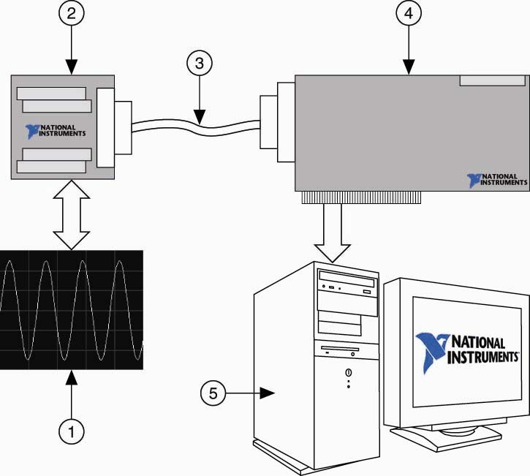
Data Acquisition (DAQ)
Signal
Terminal Block
Cable
DAQ Device
Computer

Slide 5
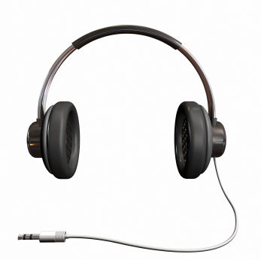
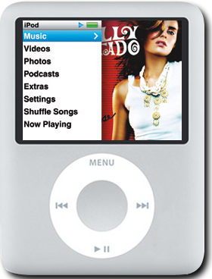
Data Acquisition (DAQ) with myDAQ
Signal 2. myDAQ 3.Computer
3.5mm cable
USB

Slide 6
Data Acquisition (DAQ): Software
NI-DAQmx
Driver level software
Detects DAQ devices
Installs NI-DAQmx functions in LabVIEW
Measurement & Automation Explorer (“MAX”)
Configure and test DAQ device
DAQ Assistant
Configurable Express VI used to create a DAQ application
DAQmx API
Provides a set of VIs to program DAQ applications
Notes:
The final component of a complete Data Acquisition System is the software. In this section we will discuss the different levels of DAQmx software that are used to program your DAQ device. The three levels are NI-DAQmx, Measurement & Automation Explorer (MAX), and LabVIEW. The remainder of this chapter will contain an overview of NI-DAQ and MAX. The remaining five chapters will focus on using LabVIEW.

Slide 7
Measurement & Automation Explorer
Configure and test DAQ device
Verify:
- Installed devices
- Installed software
Available remote devices
Access wiring diagrams
Notes:
Measurement & Automation Explorer (MAX) is a utility that allows you to do many things regarding data acquisition and instrument control devices. When first installing a device or software package, MAX can help you verify that everything is installed properly and communication with device is working.

Slide 8
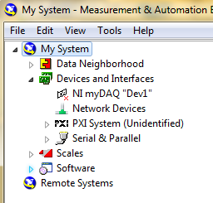
Measurement & Automation Explorer
My System – the local computer; the one you are currently using
Remote Systems – computers or devices (cRIO, PXI) that are available to communicate with local computer through the internet
Devices and Interfaces- list of installed devices (on local computer is under My System)
Device currently installed
Device previously installed but not currently installed
Device ?????
Notes:
MAX separates the local system from remotes systems. Under My System, you can expand Devices and Interfaces to see which devices are currently installed or were previously installed. Each devices will be given an alias such as Dev1 which will be used to identify the device in LabVIEW when creating tasks.

Slide 9
Demonstration:
Using Measurement & Automation Explorer (MAX)
- Plug in your myDAQ and verify you can see it in MAX
Notes:
Launch MAX
Show configuration of device
Show configuration of accessory – BNC2110
Introduction to LabVIEW Hands-On 24 ni.com

Slide 10
DAQ terminology
Task: DAQmx’s method of organizing Analog Input, Analog Output, Digital Input, Digital Output under-the-hood; cannot have AO and AI in the same task
Channel: physical connection on the DAQ device; place where the wire(s) connect
Virtual Channel: DAQmx’s representation of a corresponding physical channel
Sampling Rate (Hz): how often data points (samples) are acquired or generated.
Sample Mode: method of acquiring data- one point at a time, in chunks or continuously

Slide 11
DAQ Assistant
Quick way to create a VI that acquires data.
Place DAQ Assistant on block diagram -> configuration window will pop up -> configure your device -> press OK and LabVIEW will build the DAQ task

Slide 12
Demonstration:
Configuring the DAQ Assistant
Notes:
Drop a DAQ Assistant. Show how to select in or out, digital or analog.
Show how to select voltage or other parameter
Introduction to LabVIEW Hands-On 24 ni.com

Slide 13
DAQmx API
DAQmx API: set of DAQ functions
Notes:
Create Virtual Channel VI
Creates a virtual channel and adds it to a task
Use pull-down menu to select the appropriate instance of this VI
Configure timing if reading multiple samples
Sample rate, timing source, etc
Configure triggering if necessary for application
Configures the task to start or stop on a rising or falling digital edge, analog edge, or analog windows
Acquire or generate data from the DAQ device
Make sure pull-down menu selection is compatible with task configuration
DAQmx Clear Task VI
Stops the task
Releases any resources the task reserved
Clears the task

Slide 14
DAQ: Basic Flow
A basic DAQmx application involves the following process: only do read/write within the loop
Create
Task
Configure
Task
Start
Task
Acquire or
Generate
Data
Clear
Task
Notes:
Create Virtual Channel VI
Creates a virtual channel and adds it to a task
Use pull-down menu to select the appropriate instance of this VI
Configure timing if reading multiple samples
Sample rate, timing source, etc
Configure triggering if necessary for application
Configures the task to start or stop on a rising or falling digital edge, analog edge, or analog windows
Starts the task after the task has been configured
Acquire or generate data from the DAQ device
Make sure pull-down menu selection is compatible with task configuration
DAQmx Clear Task VI
Stops the task
Releases any resources the task reserved
Clears the task

Slide 15
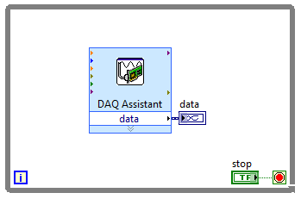
DAQ: Example
Using the DAQmx API
Using DAQ Assistant

Slide 16
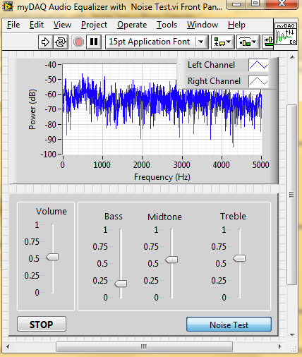
myDAQ Activity: Audio Equalizer
https://decibel.ni.com/content/docs/DOC-8435

Slide 17
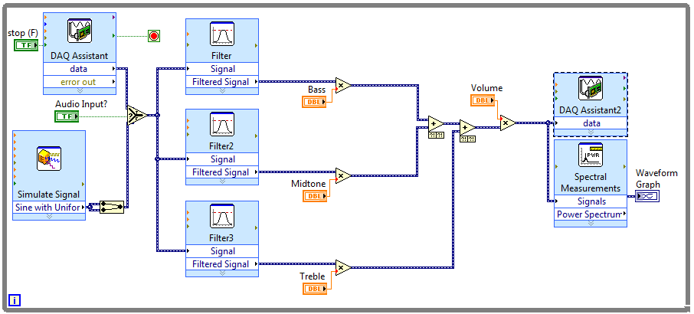
myDAQ Activity: Audio Equalizer
Filters
Lowpass:
Cutoff Frequency 400 Hz
Bandpass:
Low cutoff frequency: 450
High cutoff frequency: 2500
Bandpass:
Low cutoff frequency: 3000
High cutoff frequency: 10000
DAQ Assistant 2:
- Output >> Voltage
- Signal Output Range: -2 to 2 V
- Samples to Write: 100
- Generation Mode: Continuous
DAQ Assistant 1:
Input >>Voltage
Signal Input Range: -2 to 2 V
Acquisition Mode: Continuous
Samples to Read : 20k
Rate (Hz): 100k
Simulate Signal
Add Noise
Amplitude: 0
Noise Amplitude: 0.6
Sampling Rate: 100,000
Number of Samples: 20,000
Spectral Measurements
- Power Spectrum
https://decibel.ni.com/content/docs/DOC-8435

Slide 18
Demonstration:
Completed Audio Equalizer
Notes:
Introduction to LabVIEW Hands-On 24 ni.com

Slide 19
Homework
Study for CLAD
Go to ni.com/duke for CLAD Review Resources
Take the practice exams
Review the Study Guide
Notes:
Introduction to LabVIEW Hands-On 24 ni.com

