Slide 1
Welcome!
Workshop
5 of 7

Slide 2
Today's Topics
Review from Workshop 4
Modularity & subVIs
Documentation
File Input/Output Introduction

Slide 3
Review Question 1
True or False?
A sequence structure can be aborted in the middle of the sequence.

Slide 4
Review Question 1
True or False?
A sequence structure can be aborted in the middle of the sequence.
FALSE
Notes:
Sequence structures are typically avoided because the CANNOT be aborted in the middle of a sequence. There are some cases in which this feature is desired which makes the sequence structure (flat or stacked) ideal. However, data flow is typically encouraged with wires or other structures such as a case structure as part of a state machine.

Slide 5
Review Question 2
Which is best to use when monitoring the passage of time over a period of 24 or more hours?
Tick Count
Get Date/Time in Seconds
Elapsed Time Express VI

Slide 6
Review Question 2
Which is best to use when monitoring the passage of time over a period of 24 or more hours?
Tick Count
Get Date/Time in Seconds
Elapsed Time Express VI
Notes:
The tick count has a maximum value and when that maximum is reached it starts over at 0. If tick count “rolls over” within your time period, you may have inaccurate time measurements.
The Express VI is not preferred simply because of the amount of processor it requires. It has a timer constantly going, instead of periodically checking, which cause excessive use of the processor.

Slide 7
Review Question 3
If you have a Wait Until Next Millisecond Multiple in a while loop with a 20 wired to it and the other code within the loop take 25ms to execute, how long will one iteration of the loop take?
25 ms
40 ms
45 ms
unknown

Slide 8
Review Question 3
If you have a Wait Until Next Millisecond Multiple in a while loop with a 20 wired to it and the other code within the loop take 25ms to execute, how long will one iteration of the loop take?
25 ms
40 ms
45 ms
unknown
Notes:
The wait until next millisecond multiple sets up “opportunities” for the next loop iteration at millisecond intervals of the value wired to the function. Because 20 is wired to the function, the opportunities for the loop to go on to the next loop iteration are at 20 ms, 40 ms, 60 ms, 80 ms, etc. The other code within the loop was not complete until after the first opportunity, so the next loop iteration cannot begin until the second opportunity at 40 ms.

Slide 9
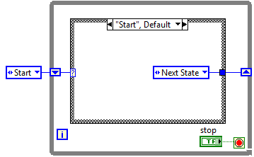
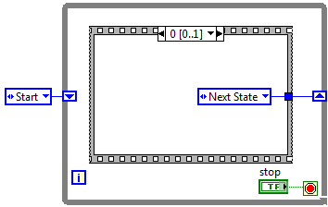
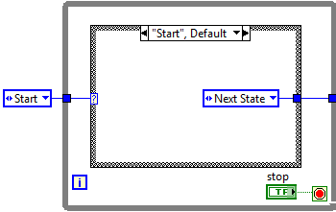
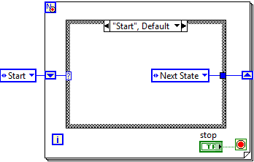
Review Question 4
Which of the following is a state machine?
Notes:
http://zone.ni.com/devzone/cda/tut/p/id/3024 <- article on state machines from ni.com with a great coke machine example.

Slide 10
Review Question 4
Which of the following is a state machine?
Notes:
http://zone.ni.com/devzone/cda/tut/p/id/3024 <- article on state machines from ni.com with a great coke machine example.
A state machine is made of a while loop (not a for loop), case structure (not a sequence structure), and a shift register. Enums are often used to pass which state is next.

Slide 11
Review Question 5
Which block diagram objects compose a state machine?
While loop
Enum
Sequence structure
Case structure
Shift register
Numeric constants

Slide 12
Review Question 5
Which block diagram objects compose a state machine?
While loop
Enum (optional, although often used)
Sequence structure
Case structure
Shift register
Numeric constants
Notes:
The while loop allows you to repeatedly go to the next state. The case structure holds the unique code for each state. The shift register is required to pass the next state declaration to the case selector on the next loop iteration.
Enums make the code easier to read with regards to case/state names, but are not required.

Slide 13
Modularity and SubVIs
Modularity - The degree to which a program is composed of discrete modules such that a change to one module has minimal impact on other modules
Module = subVI
It is desirable to section code into reusable parts that can be edited without having to change a bunch of other parts too.
Notes:
Modularity refers to the ability to bundle functions in a manner that the internals of the function/subVI can be altered/corrected/changed, but the change does not require other changes in other parts of the VI. A change to a VI that is not modular will result in a domino effect of changes. A highly modular VI is more desirable. In LabVIEW, a subVI is an example of a module.

Slide 14
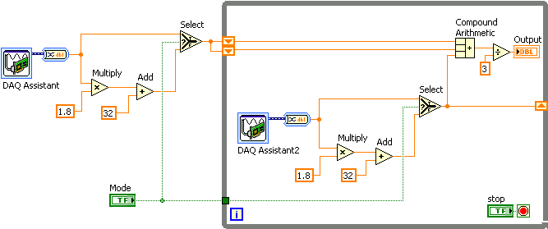
Modularity and SubVIs
Notes:
Can you identify a section of code in this VI that is repeated? Could that section be placed in a subVI, so the subVI could be reused instead of re-writing that section of code?

Slide 15
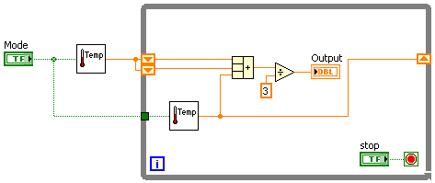
Modularity and SubVIs
Notes:
Now that the repeated section of code has been placed into a subVI, the VI looks cleaner and is easier to understand. If we were to change the channel that the data was being read from, we could edit the subVI and wouldn’t have to change anything in the main VI because the subVI outputs the temperature, not raw data.
The subVI icon is descriptive because we can tell that it involves something with temperature.

Slide 16
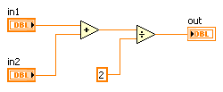
Modularity and SubVIs
Function Code | Calling Program Code
function average (in1, in2, out) { out = (in1 + in2)/2.0; } | main { average (point1, point2, pointavg) }
SubVI Block Diagram | Calling VI Block Diagram
Notes:
This slide is comparing a subVI/function with a main program/VI. From the perspective of the main program, we only know that we are passing two values into a function/subVI called average or 2 point average and getting one value returned. If we were to look inside the subVI/funciton, we would see that they both have two inputs which they add and divide by 2. The single value result is then passed out of the subVI/function back to the main caller/VI.

Slide 17
SubVI Icon
Conveys the functionality of the VI using:
Relevant graphics
Descriptive text
Create template for related subVIs
i.e. DAQmx
Notes:
It is important to use a descriptive icon and name for a subVI. Naming a subVI “subVI 1”, “subVI 2”, “subVI3” etc. does not tell you or any other programmer that may look at your code what is going on inside the subVI. A descriptive name and icon can provide an intelligent guess. If subVI’s are related in function (like DAQmx does various functions related to data acquisition), it is a good idea to make the subVIs look related. Templates are available to help create a common icon.

Slide 18
Icon and Connector Pane: Setting up the Connector Pane
Right-click the icon in the upper right corner of the front panel and select Show Connector
Each rectangle on the connector pane represents a terminal
Select a different pattern by right-clicking the connector pane and selecting Patterns from the shortcut menu
Notes:
The connector pane defines what can be passed in and out of the subVI. You can get to the connector pane by right-clicking on the icon FROM THE FRONT PANEL and selecting Show Connector. You can right click on the (now showing) connector pane and select Patterns to see the pattern options available.

Slide 19
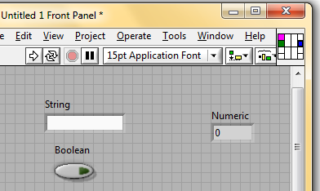
Icon and Connector Pane: Setting up the Connector Pane
Once the connector pane pattern is selected,
Click on a terminal in the connector pane
Click on a control/indicator on the front panel
The control/indicator and connector pane terminal are now linked
The terminal will display the color of the data type of the linked control/indicator
Notes:
To connect a front panel object (control or indicator) to the connector pane:
Click on one of the areas in the connector pane while your mouse looks like a wiring tool
Click on the front panel object you want to associate with that connector pane terminal.
The location of the terminal directly correlates with the input/output sinks/sources on the subVI when used in a main VI.

Slide 20
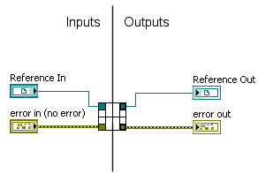
Connector Pane: Standards
Use this connector pane layout as a standard
Top terminals are usually reserved for references, such as a file reference
Bottom terminals are usually reserved for error clusters
Notes:
The standard layout for the connector pane is shown in this slide.
Typically, top terminals are reserved for reference input/output and bottom terminals are reserved for error clusters. Also, inputs should go to the left, and outputs to the right.

Slide 21
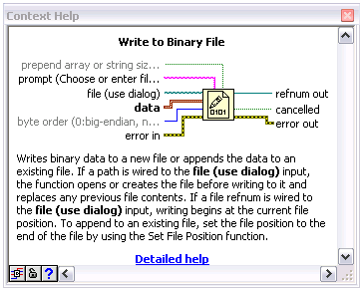
Connector Pane: Terminal Settings
Bold: Required terminal
Plain: Recommended terminals
Dimmed: Optional terminals
Notes:
You can designate which inputs and outputs are required, recommended, and optional for your subVIs
Right-click a terminal in the connector pane and select This Connection Is.
Select Required, Recommended, or Optional.
LabVIEW sets inputs and outputs of VIs you create to Recommended by default.
Set a terminal setting to required only if the VI must have the input or output to run properly, because if a required terminal is not wired the run arrow will be broken.
The status will appear in Context Help as bold, plain, dimmed, respectively.

Slide 22
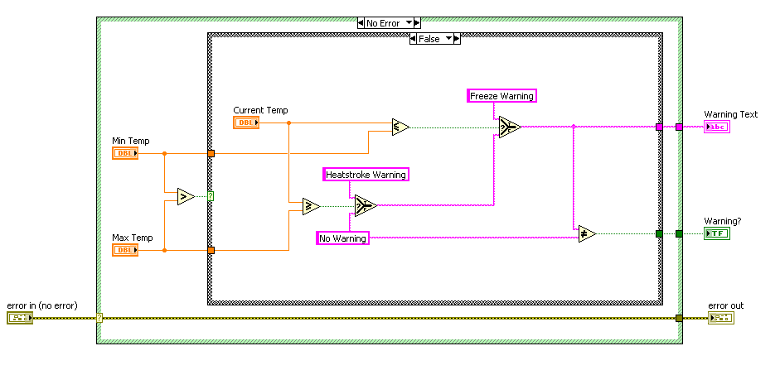
Using SubVIs: Handling Errors
Use a Case structure to handle errors passed into the subVI
Notes:
It is good practice to execute a subVI only if there is not an error passed to it. It is often a waste of time/resources if you run code when the data passed to that part of code was “bad” because some error occurred upstream. Putting a case structure around the code that makes up a subVI and wiring an error input cluster to the selector terminal is a great way to bypass the code if an error is passed to the subVI. In other words, leave the error case blank (with the exception of some constants wired to output so the tunnels have something wired to them in each case), so that if an error is passed into the VI the Error case will run (quickly) instead of the No Error case (which contains the subVI code).

Slide 23
Creating SubVIs
You can use an existing VI as a subVI after making the appropriate connections in the connector pane.
Drag the VI from the project to the block diagram of another VI
Drag the VI icon (top right corner of the VI) to the block diagram of another VI
LabVIEW will create a subVI from selected code on the block diagram
Edit » Create SubVI
Edit » Create SubVI

Slide 24
Demonstration:
Creating a subVI
Notes:
- Create a subVI - Edit the Icon - Wire Connector Pane -
Introduction to LabVIEW Hands-On 24 ni.com

Slide 25
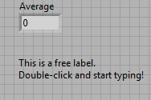
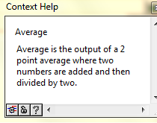
Documentation
Free labels
(standard) labels
Descriptions
Captions
Tip Strips
Notes:
Caption
Front panel objects also can have captions. You can use captions instead of labels to localize a VI without breaking the VI. Unlike a label, a caption does not affect the name of the object, and you can use it as a more descriptive object label. The caption appears only in the front panel window.
If you assign the object to a connector pane terminal, the caption appears in a tip strip when you use the Wiring tool to move the cursor over the terminal on the block diagram. The caption also appears next to the terminal in the Context Help window if you move the cursor over the connector pane or VI icon.

Slide 26
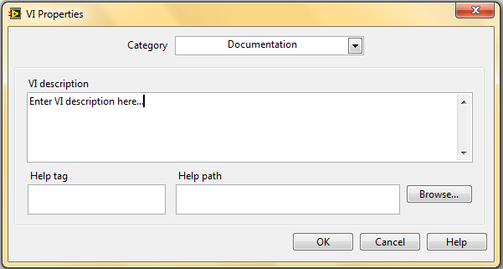
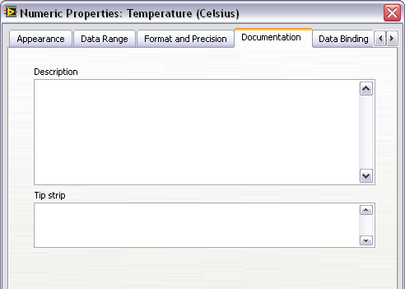
Documentation: Description and Tip Strips
Descriptions- appear in the Context Help window when you move the cursor over the object
VIs: VI Properties» Description
Controls, indicators, and constants: Properties » Description
Tip Strips
Brief description of the object to display when you move the cursor over a front panel object while a VI runs. (controls, indicators, and constants)
Notes:
Descriptions of VIs and controls, indicators, and constants appear in the Context Help Window when your cursor hovers over them.
A VI description is added by editing the VI Properties: Description field. You can get to VI Properties through the File» VI Properties or by right-clicking on the VI icon and selecting VI Properties (in the upper-right corner; not a subVI icon). A VI Properties window will appear like top image in this slide. Select Documentation from the drop-down menu and enter your description.
A description for a control, indicator, or constant is created by right-clicking on the object and selecting Properties from the short-cut menu. Click on the Documentation tab and enter the description. The tip strip field is available here as well. Tip strips are short messages to help a user by popping up when the cursor is over the object and the VI is running.
Here is LabVIEW Help’s information on Descriptions and Tip Strips:
Description—Contains a description of the object. Descriptions for controls, indicators, and constants appear in the Context Help window when you move the cursor over the object. You can enter a description for a VI or function located on the Functions palette but you can only view the description in this dialog box. The description will not appear in the Context Help window. You can format the text in the description to appear bold in the Context Help window. If you want to display a carriage return in the Context Help window, you must separate paragraphs with two carriage returns.
Tip—Brief description of the object to display when you move the cursor over a front panel object while a VI runs. The Tip text box is available only for controls, indicators, or constants. You cannot enter tip information for VIs or functions.

Slide 27
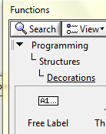
Documentation- Labels and Captions
Labels (including free labels) are available on the front panel and block diagram
Captions are only available on the front panel – use when you want to be more descriptive and…
don’t want to take as much space on the block diagram
programmatically use the label and don’t want to break your VI
To create a free label:
Double-click and begin typing
Place a free label form the Functions palette
Be descriptive!
For example,
Does “Temp” mean temporary or temperature?
What are the units of “Temp”?
Notes:
Front panel objects also can have captions. You can use captions instead of labels to localize a VI without breaking the VI. Unlike a label, a caption does not affect the name of the object, and you can use it as a more descriptive object label. The caption appears only in the front panel window.
If you assign the object to a connector pane terminal, the caption appears in a tip strip when you use the Wiring tool to move the cursor over the terminal on the block diagram. The caption also appears next to the terminal in the Context Help window if you move the cursor over the connector pane or VI icon.
Right-click the object and select Visible Items»Caption from the shortcut menu to show or hide the caption.
Note When the text of the caption changes, LabVIEW does not need to recompile the VI or its callers. You also can use the Text property to change the text of a caption programmatically or use the Caption property to reference the caption.
Note You must first create the caption before you use the Text or Caption property, or LabVIEW returns an error. LabVIEW creates the caption the first time you set the caption to visible.

Slide 28
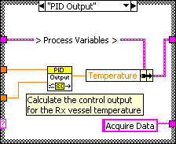
Documentation- Block Diagram
Use block diagram comments to:
Describe algorithms
Explain the data contents of wires
LabVIEW 2010 and later: right-click on wire select Visible»Label
LabVIEW 2009 and earlier: use a free label to label wires
Using Unbundle/Bundle By Name creates self-documenting code
Notes:
Use the following guidelines when commenting your VIs:
Comments:
Use to document algorithms that you use and add reference information
Label structures to specify the main functionality
Label long wires to identify their use/contents
Label constants to specify the nature of the constant
Do not show labels on functions and subVIs - a developer can find information about a function or subVI by using the Context Help window

Slide 29
Demonstration:
Adding a VI Description and Free Labels
Notes:
Introduction to LabVIEW Hands-On 24 ni.com

Slide 30
File Input/Output
At their lowest level, all files written to your computer’s hard drive are a series of bits
Binary
TDMS
ASCII
LVM
Notes:
LVM (LabVIEW Measurement)
ASCII (American Standard Code for Information Interchange)
TDM (Technical Data Management)
In LabVIEW, three of the most common techniques for storing data are:
ASCII file format
direct binary storage
TDMS file format
Arrow size is to indicate increasing file size.

Slide 31
File Input/Output: File Formats
LabVIEW can use or create the following file formats:
LVM— The LabVIEW measurement data file (.lvm) is a tab-delimited text file you can open with a spreadsheet application or a text-editing application
ASCII—Specific type of binary file that is a standard used by most programs
TDMS—Type of binary file created for NI products consisting of two separate files: a binary file and a binary index file
Binary—Underlying file format of all other file formats

Slide 32
File Formats
 | ASCII | TDMS | Direct Binary
Numeric Precision | Good | Best | Best
Share data | Best (Any program easily) | Better (NI Programs easily) | Good (only with detailed metadata)
Efficiency | Good | Best | Best
Ideal Use | Share data with other programs when file space and numeric precision are not important | Share data with programs when storing simple array data and metadata | Store numeric data compactly with ability to random access
Notes:
Use text format files for your data:
To make the data available to other users or applications
If disk space and file I/O speed are not crucial
If performing random access reads or writes is unnecessary
If numeric precision is not important
Use binary format files for your data:
When numeric precision is important
When you need to randomly access stored data
When efficiency is important
A specific type of binary file, known as a Datalog file, is the easiest method for logging cluster data to file
Stores arrays of clusters in a binary representation
The storage format for Datalog files is complex, and therefore the data is difficult to access in any environment except LabVIEW
Use TDMS files for the following purposes:
To store test or measurement data
To create a structure for grouping your data
To store information about your data
To read and write data at high speeds
TDMS file format:
Binary file (.tdms) that contains data and stores properties about the data
Binary index file (.tdms_index) that provides consolidated information on all the attributes and pointers in the TDMS file
TDMS file format is publicly documented
Can use with TDM Excel Add-in Tool

Slide 33
High-Level vs. Low-Level File I/O Functions
High-level VIs
Perform all three steps (open, read/write, close) for common file I/O operations
Might not be as efficient as the functions configured or designed for individual operations
Low-level VIs
Individual VI for each step
If you are writing to a file in a loop, use low-level file I/O functions
Notes:
The high-level file i/o VIs are at the top of the File I/O palette. Low-level VIs are located below the high-level. This trend is consistent with many palettes, such as DAQ.
The biggest difference between high-level and low-level File I/O VIs is that high-level functions perform the open/create, read/write, and close. In comparison, these steps are divided out among multiple low-level VIs

Slide 34
High-Level File I/O Functions
Write to Spreadsheet File
Converts an array of double-precision numbers to a text string and writes the string to an ASCII file
Read From Spreadsheet File
Reads a specified number of lines or rows from a numeric text file and outputs a 2D array of double-precision numbers
Write to/Read from Measurement File
Express VIs that write data to or read data from an LVM or TDMS file format
Notes:
High-level File I/O functions are great for getting started or in situations when you are not streaming data (instead, a one-time read/write).
The Spreadsheet file functions use a numeric text file. If you want to use a LVM or TDMS file, use the Measurement File Express VIs.

Slide 35
Low-level File I/O
File I/O writes to or reads from a file
A typical file I/O operation involves the following process:
Open/ Create/ Replace File
Read
and/or Write to File
Close
File
Check for
Errors
Notes:
When using low-level file i/o VIs, it is very important to follow this structure: open/create the file BEFORE the loop; do reading/writing WITHIN the loop; close the file AFTER the loop.
The reason for this structure is that open/creating and closing files takes significantly more overhead than reading/writing to the file. Your program will be much more efficient by following this format.
This is a similar pattern to what we will see in data acquisition- so be on the look-out!

Slide 36
Homework
Create subVIs and document
Create a VI that uses File I/O
Notes:
Introduction to LabVIEW Hands-On 24 ni.com

